Slide 1
Philadelphia Shootings Trend Report:
All Areas
April 6, 2026 – April 12, 2026

Slide 2
Overview

Slide 3
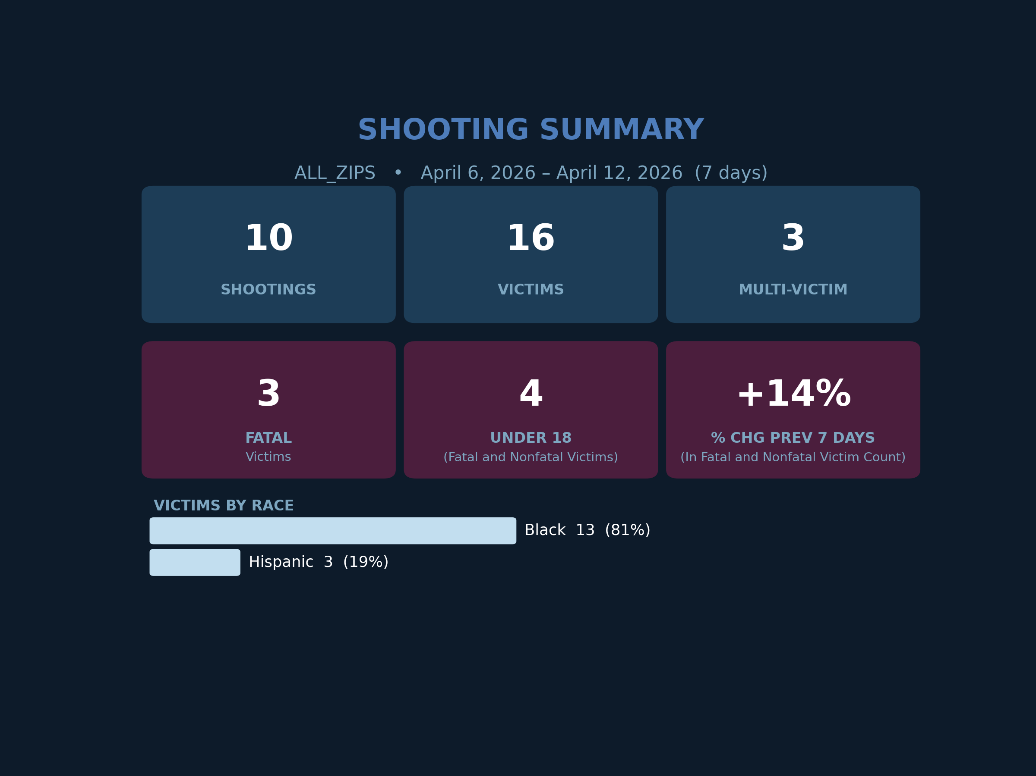
For the week of April 6th - April 12th, across the City of Philadelphia, there were:
10 shooting incidents
16 shooting victims
3 shooting fatalities
This marked a 14% increase in victimization from the previous 7 days.

Slide 4
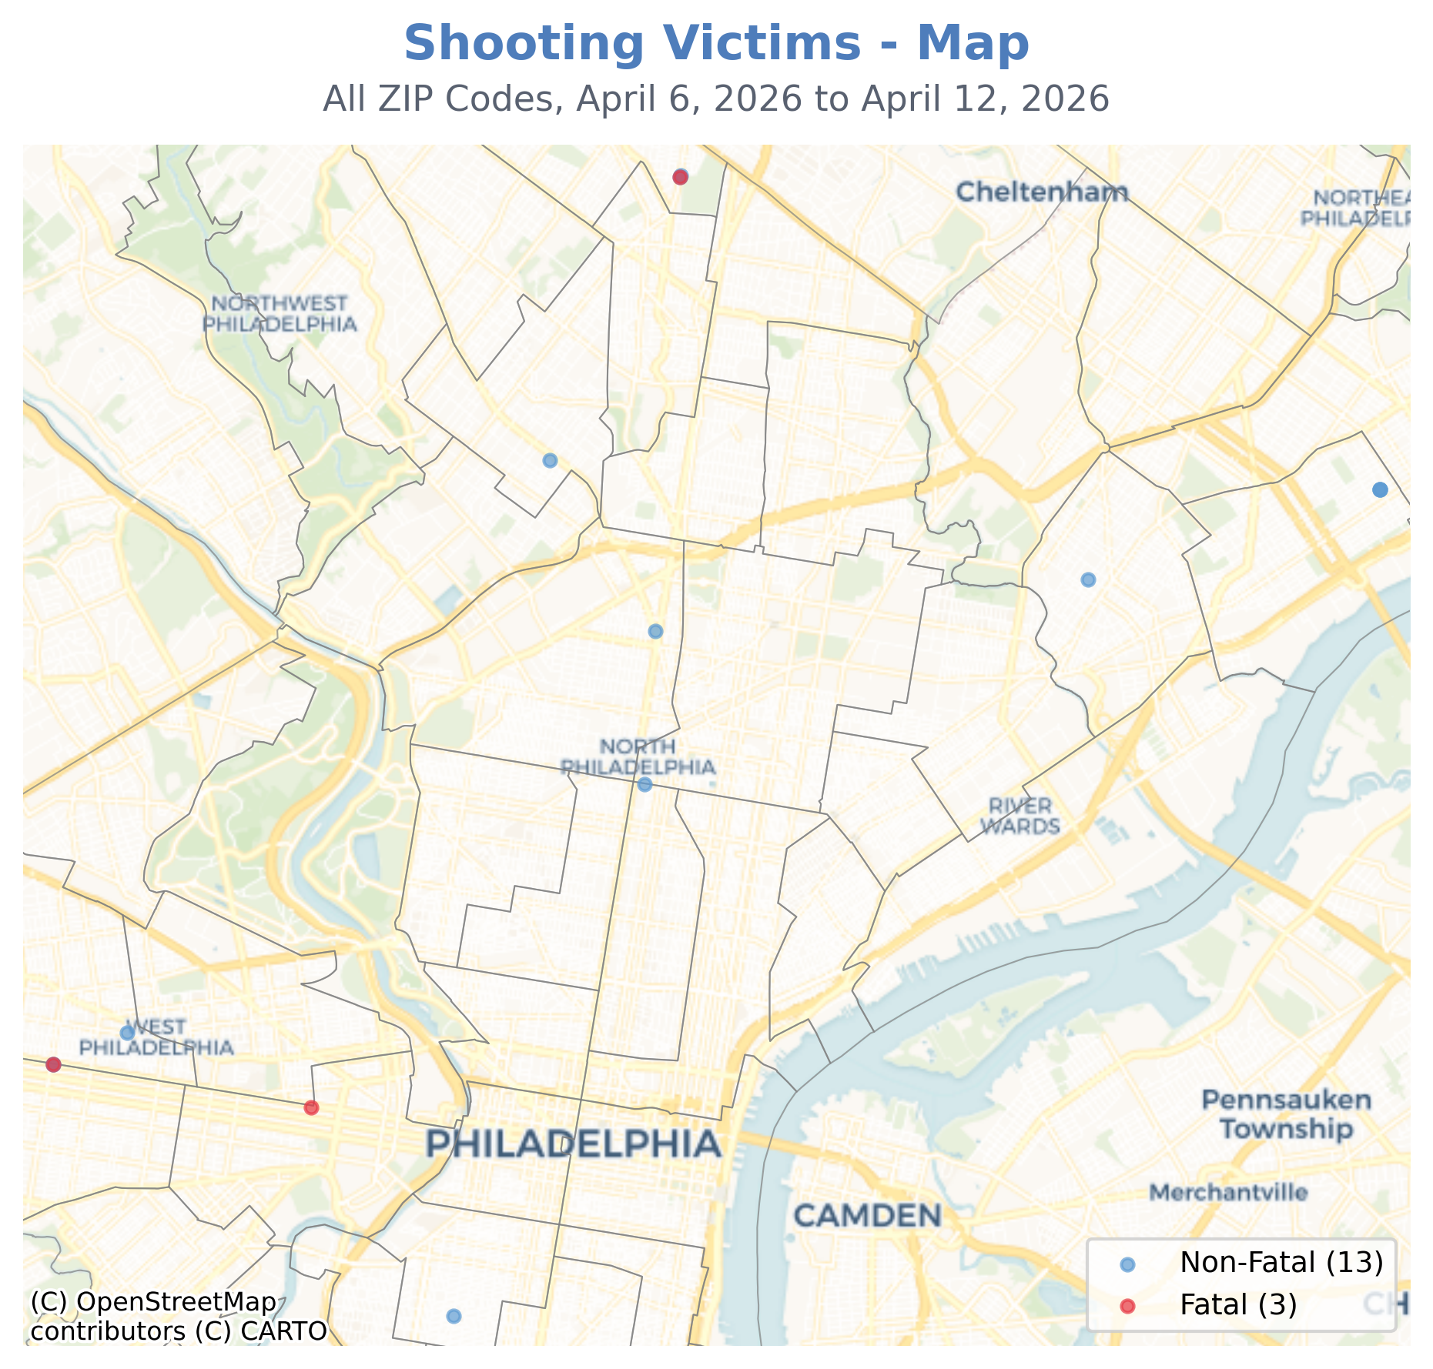
The location of all shootings are visualized in the map to the left.
(For further exploration, an interactive dashboard can be found at: https://bethevariable.com/perform-reports/)

Slide 5
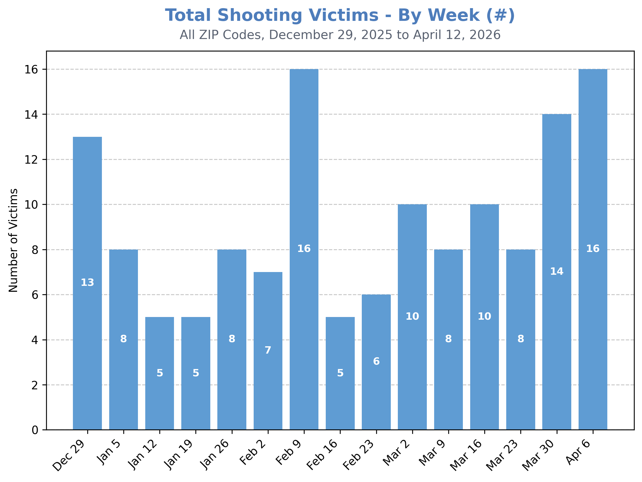
The 16 shooting victims during the week of April 6th mark the most victims in a single week year-to-date (along with the week of February 9th).
Combining the week of April 6th with the previous week (March 30th) renders the most victimization within a two-week period of the calendar year (30 victims).

Slide 6
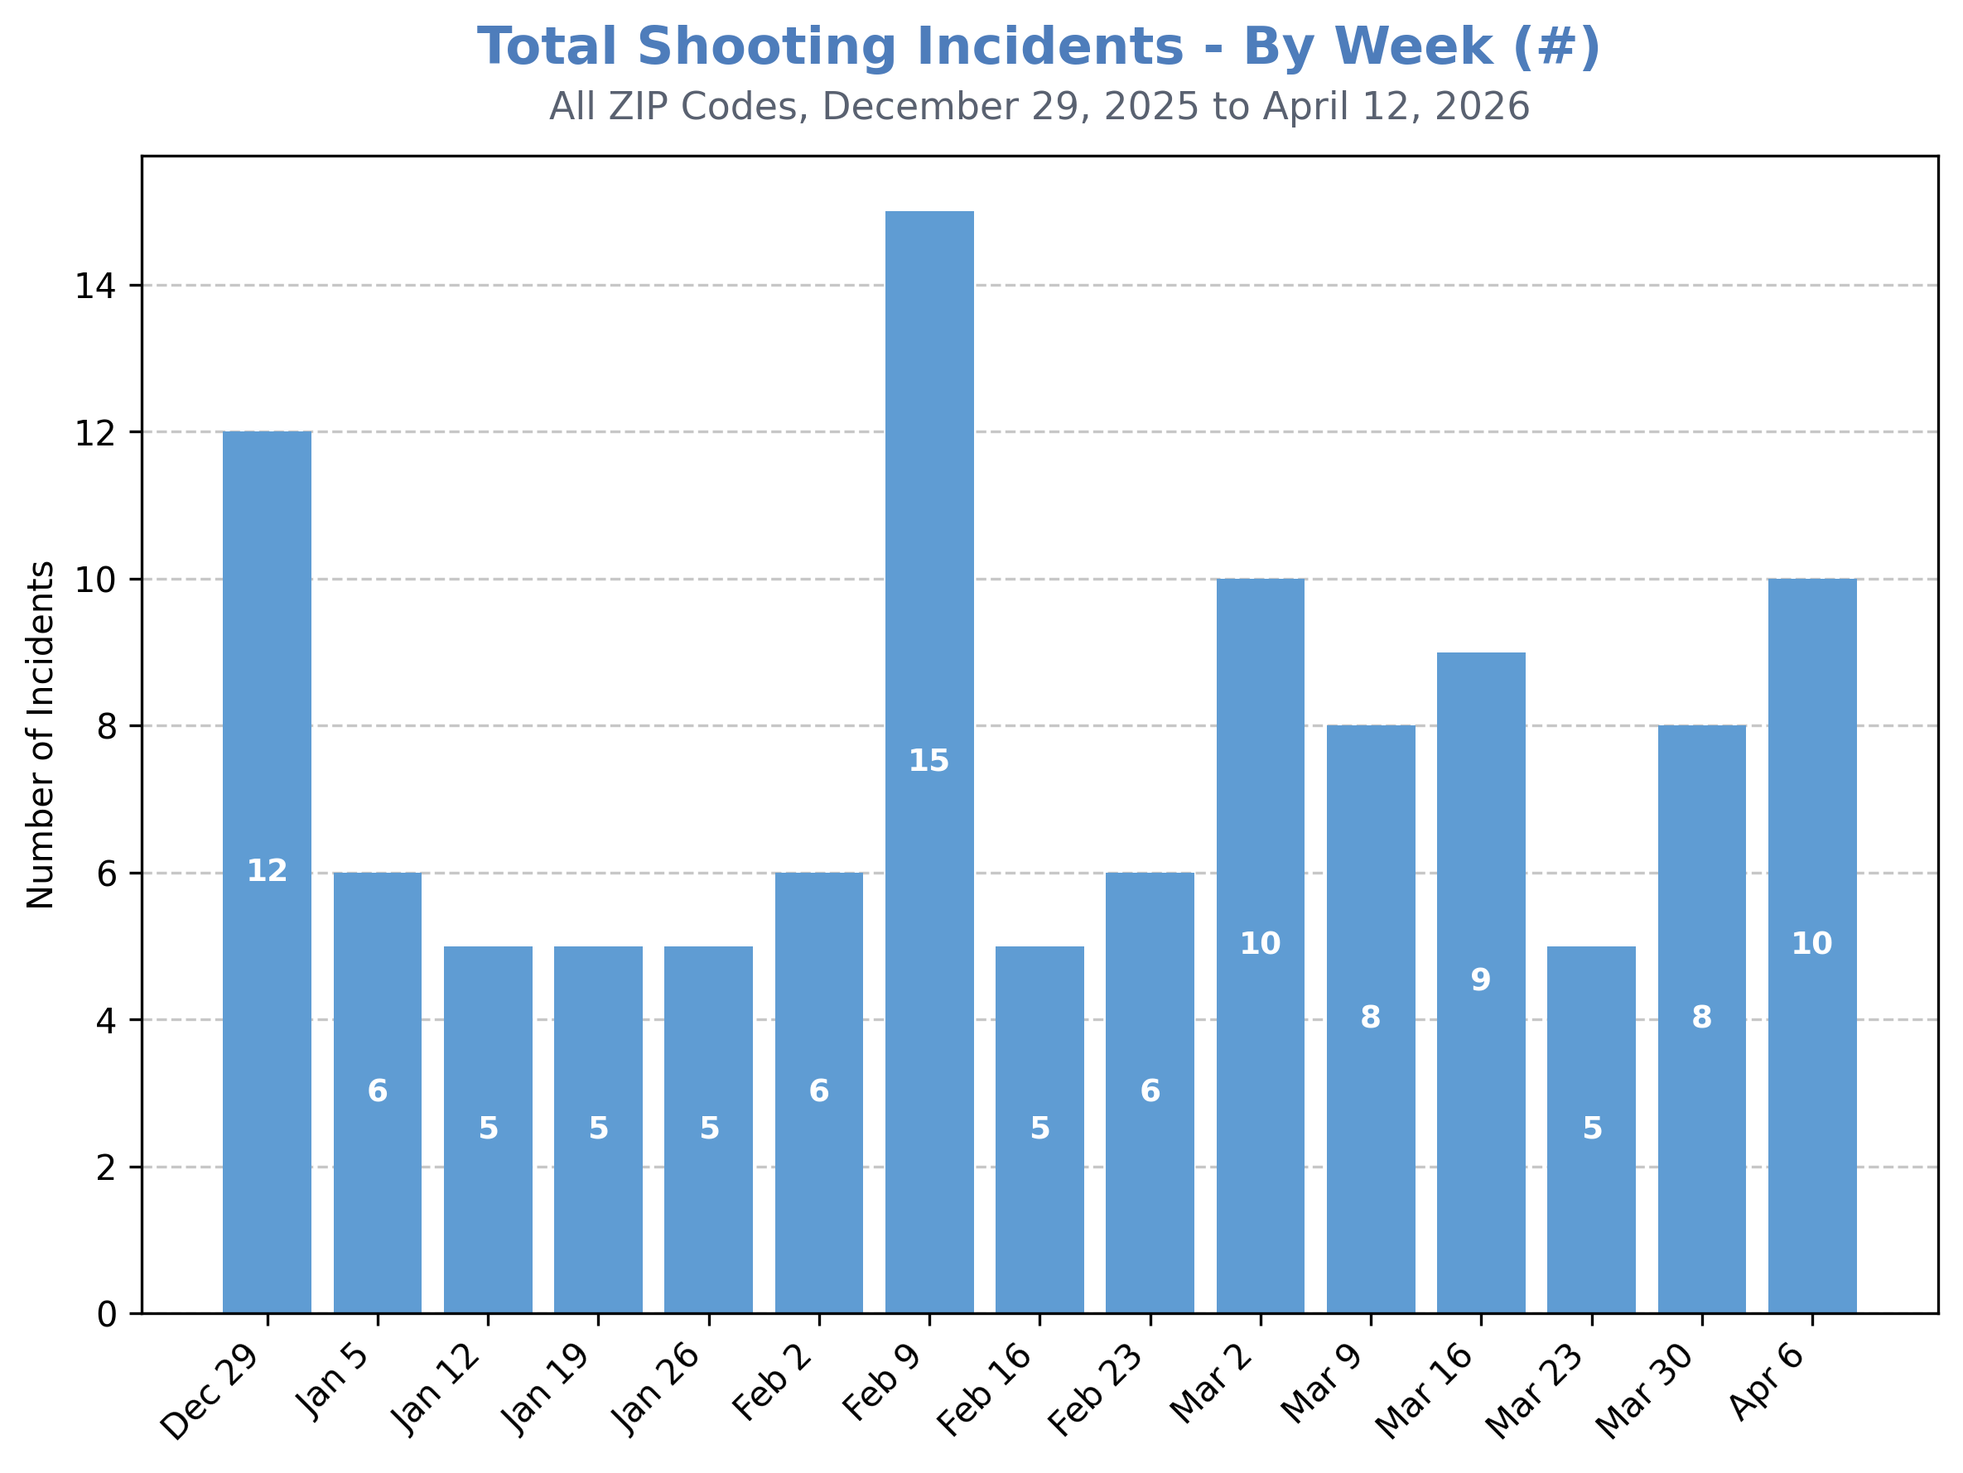
The week of April 6th saw the second most individual shooting incidents (10) of the entire calendar year.
While April 6th and February 9th both had 16 shooting victims, the week of February 9th saw a much greater number of individual shooting incidents (15).

Slide 7
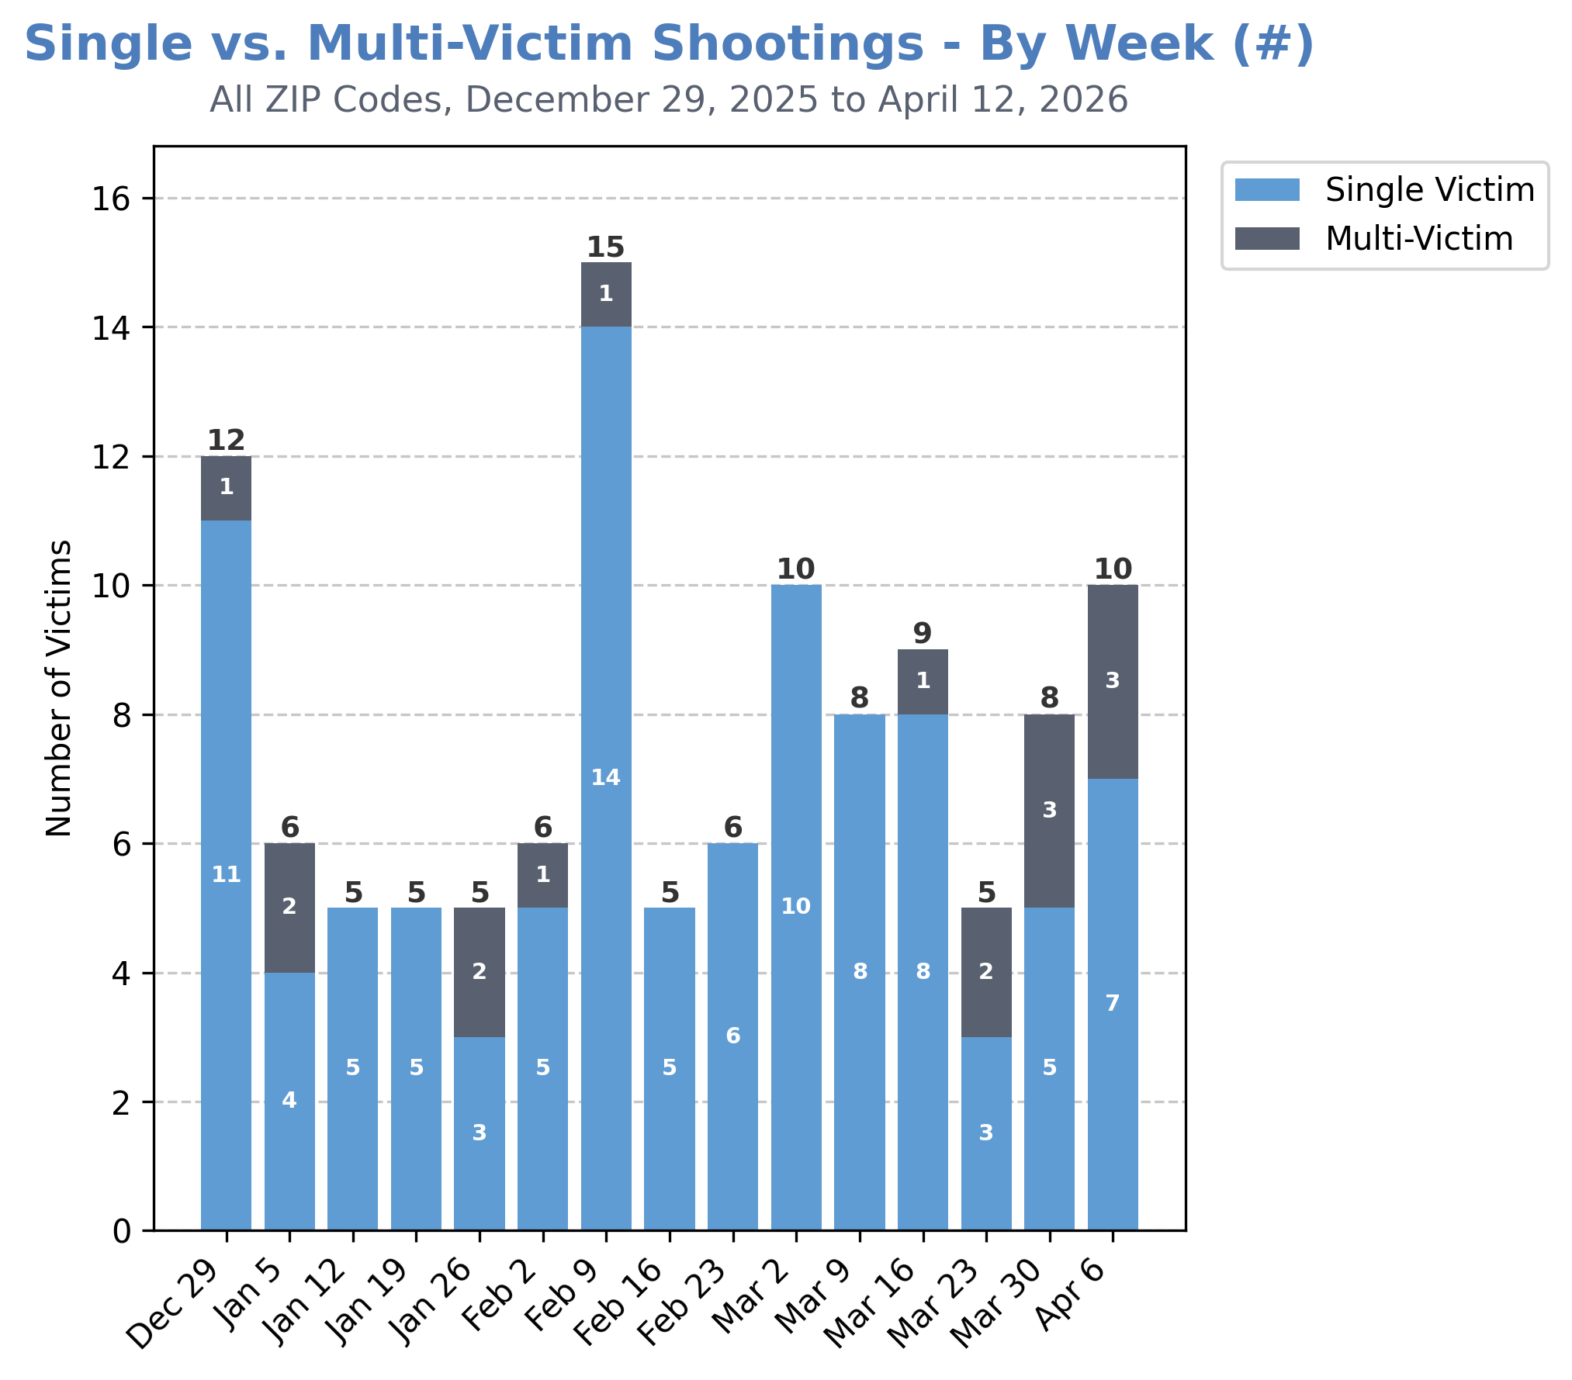
The 16 total shooting victims during the week of April 6th were the result of 10 shooting incidents.
There were 7 single-victim shooting incidents and 3 multi-victim shooting incidents.

Slide 8
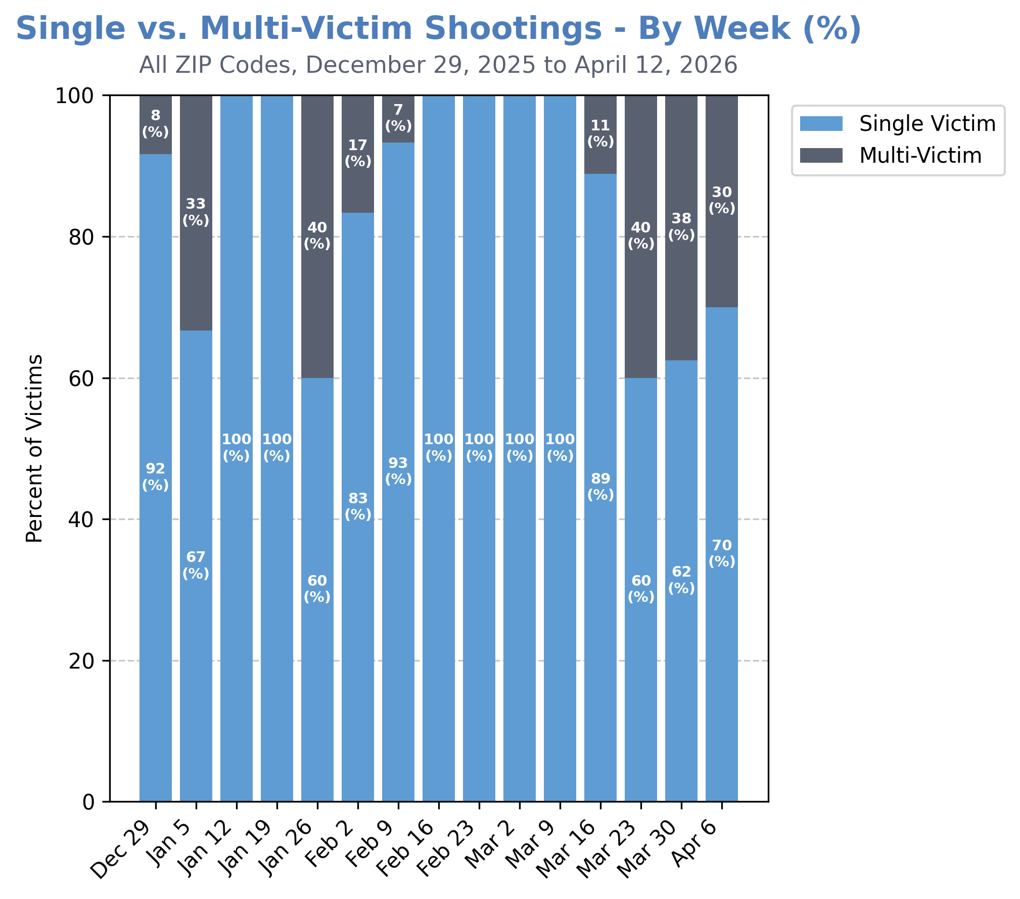
1-in-3 shooting incidents (30%) for the week of April 6th involved multiple shooting victims.

Slide 9
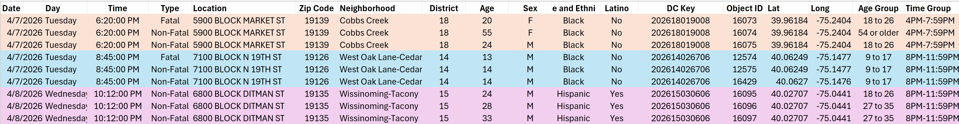
A CLOSER LOOK AT MULTI-VICTIM SHOOTINGS
There were two (2) 3-victim shootings on Tuesday, 4/7/26
  Cobbs Creek and West Oak Lane-Cedarbrook
There was one (1) 3-victim shooting on Wednesday, 4/8/26
  Wissinoming-Tacony

Slide 10
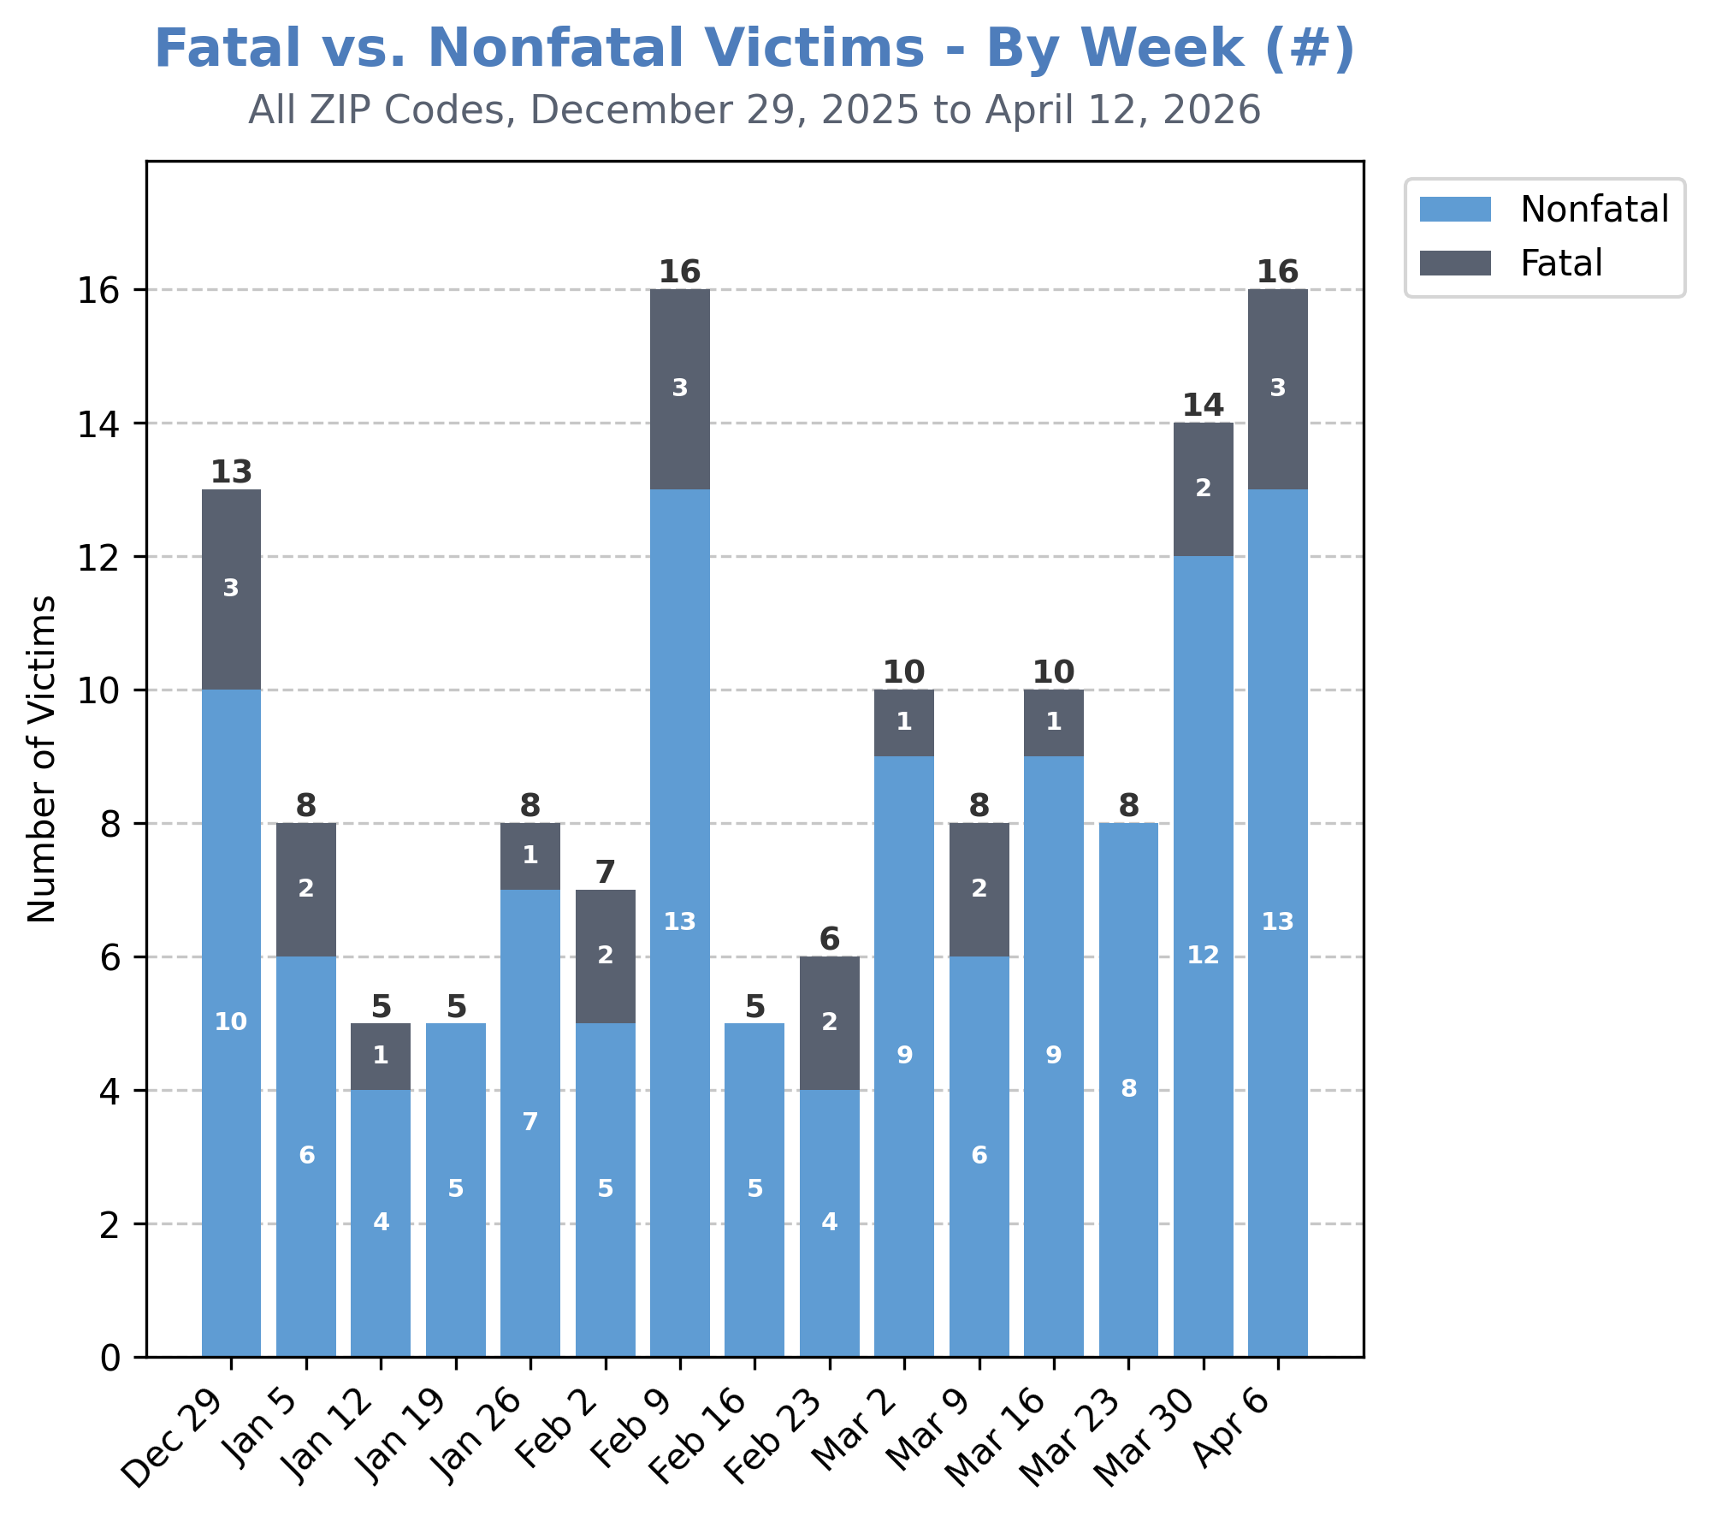
Of the 16 shooting victims during the week of April 6th, there were 3 victims who lost their lives.

Slide 11
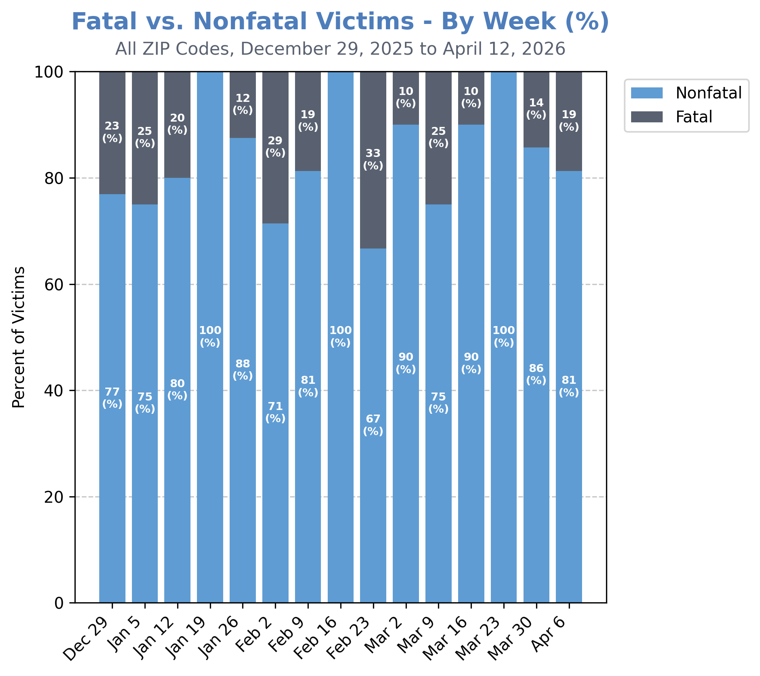
This means that 81% of shooting victims survived their injuries.

Slide 12
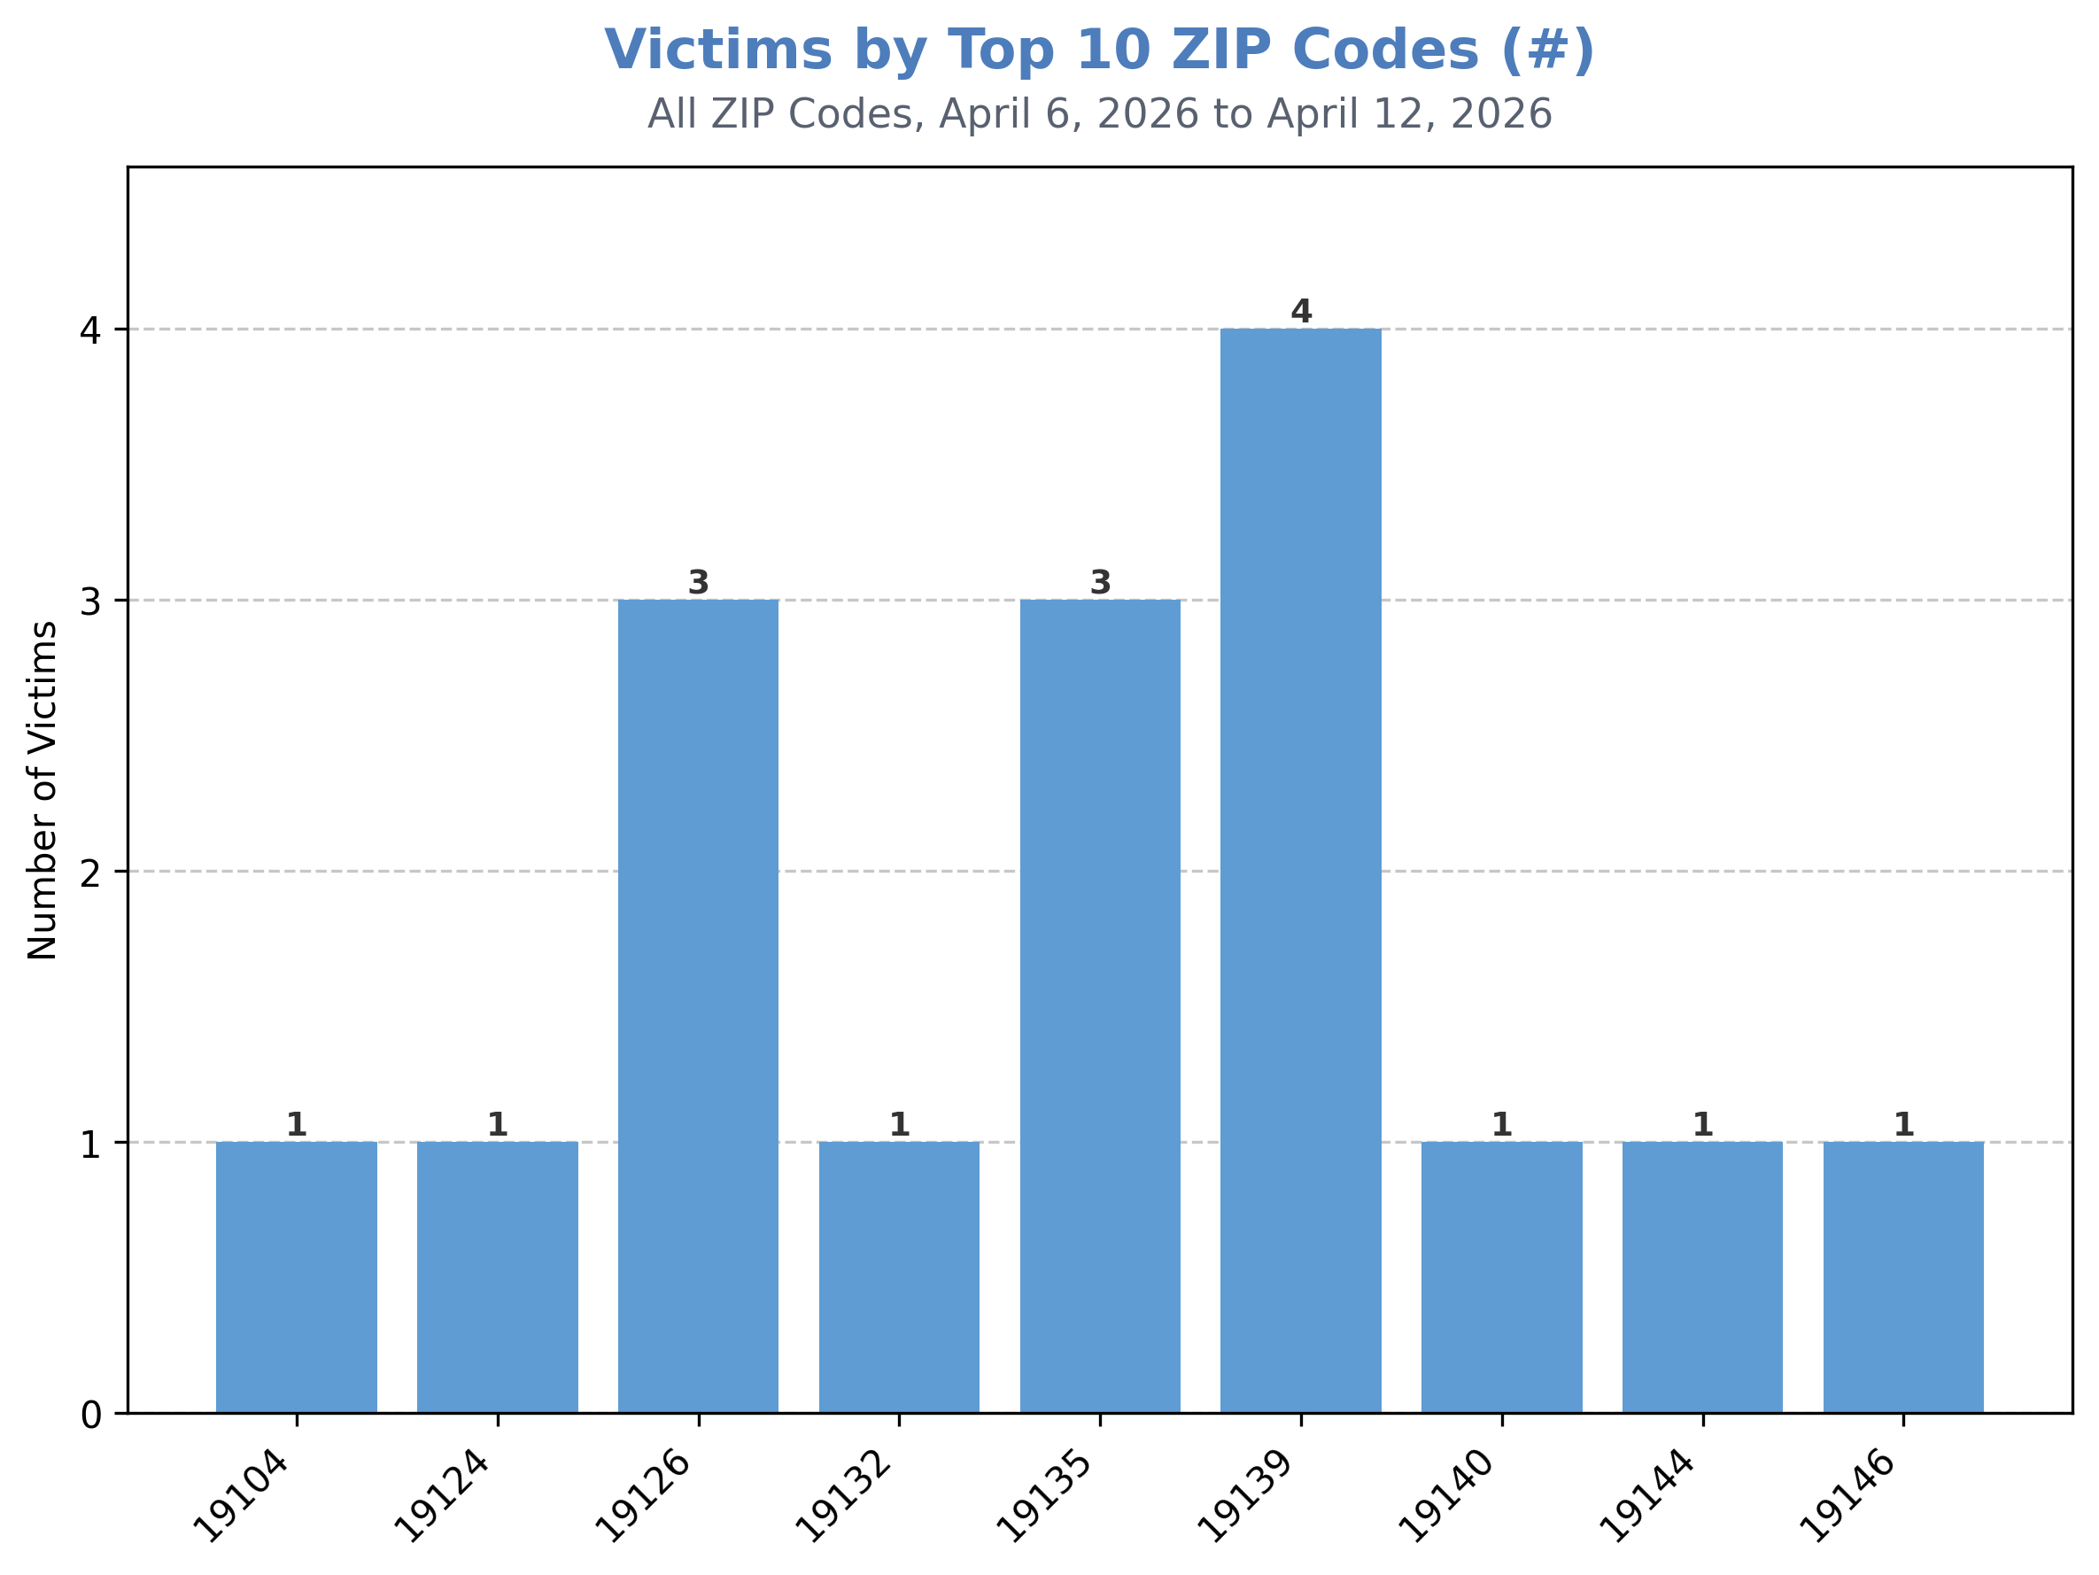
The 19139, 19126, and 19135 ZIP codes all had multiple shooting victims during the week of April 6th.

Slide 13
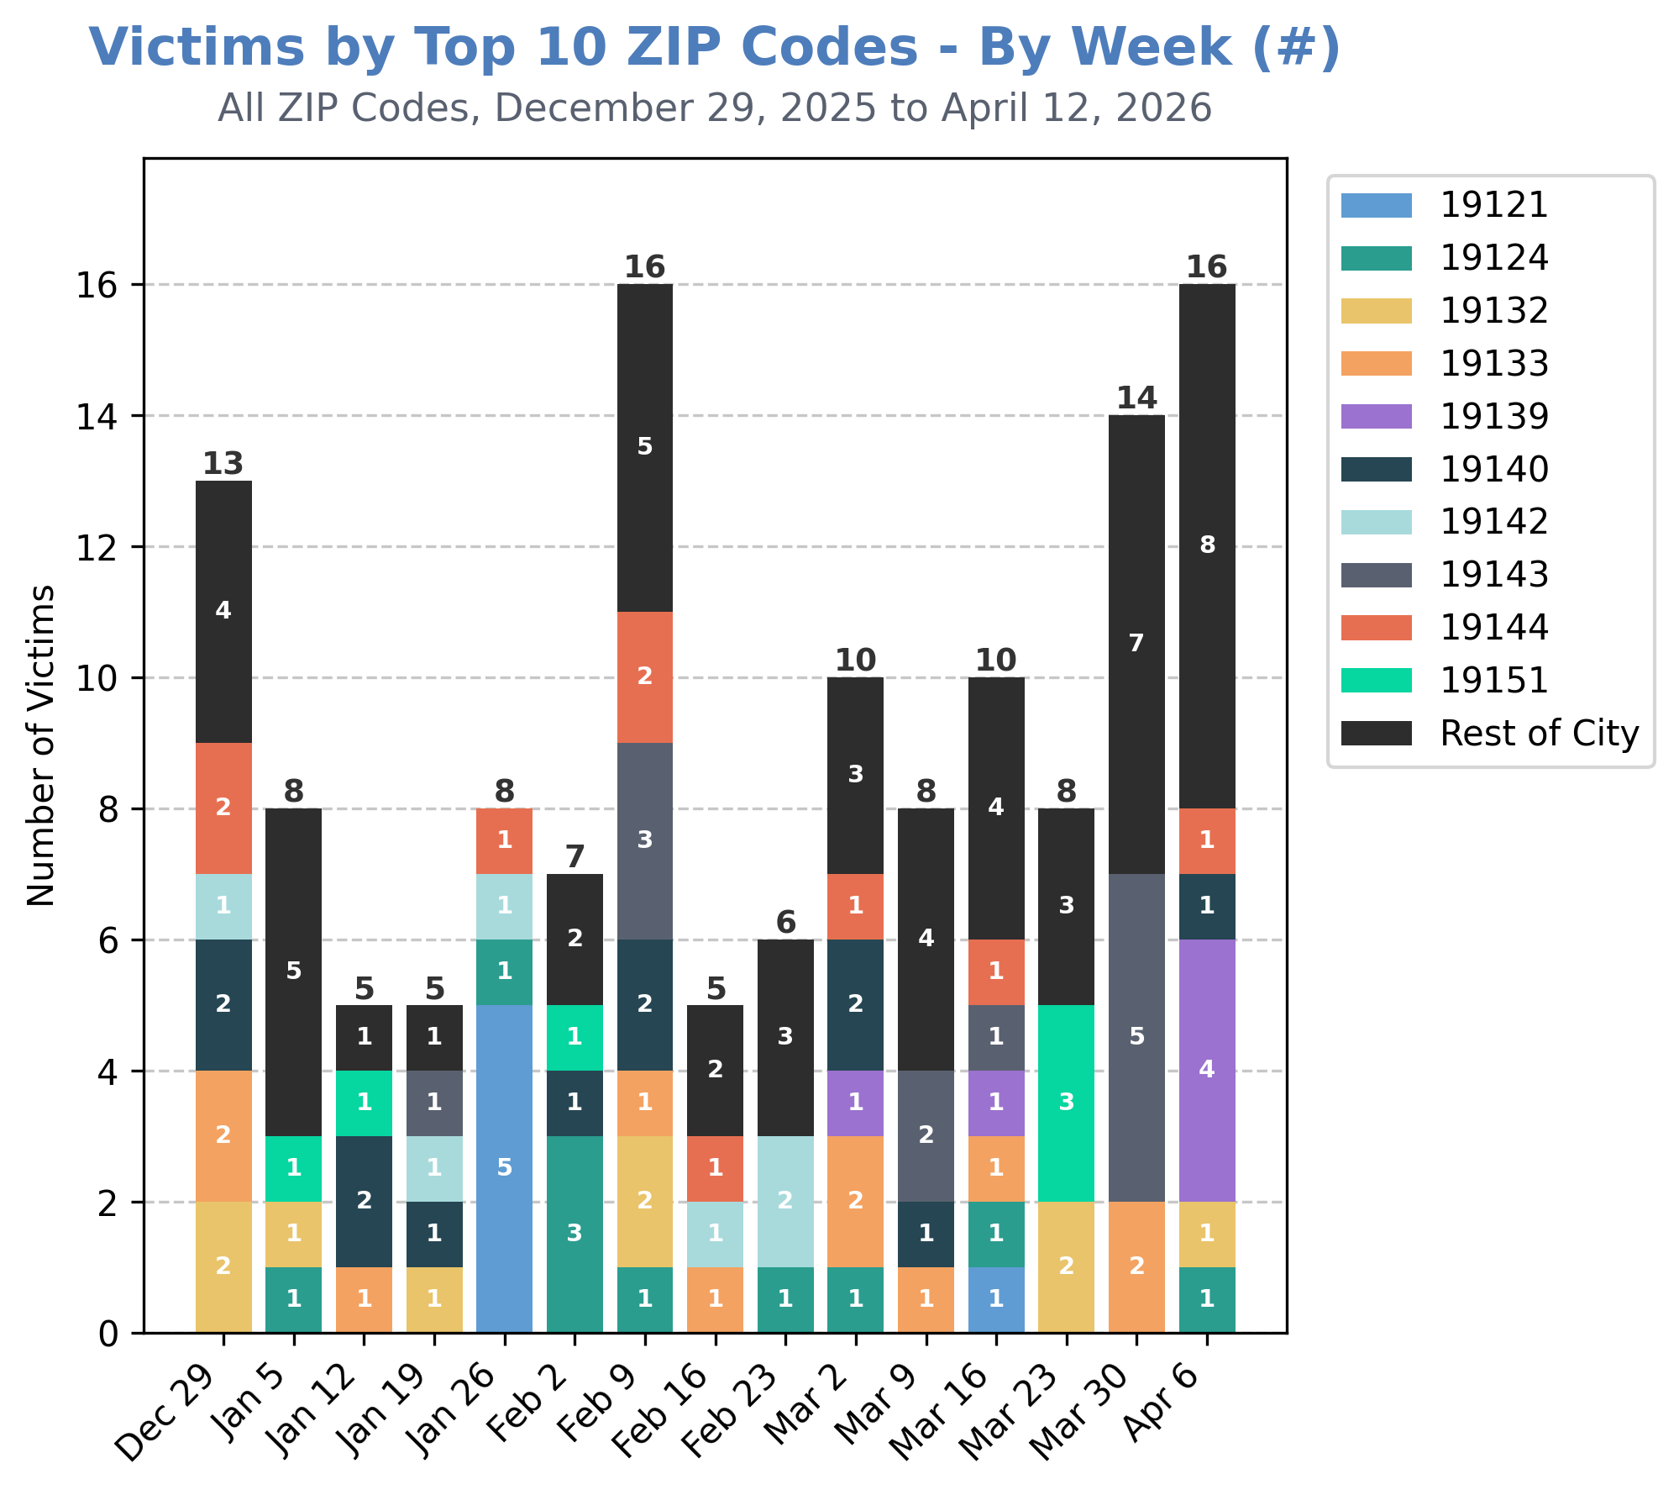
Of the top 10 ZIP codes that have seen the most victimization this calendar year, 19139 saw the most victimization during the week of April 6th (4 victims).
This marks a difference from the previous week, week, where there were no shootings in 19139 and 19143 saw the most victimization (5 victims).

Slide 14
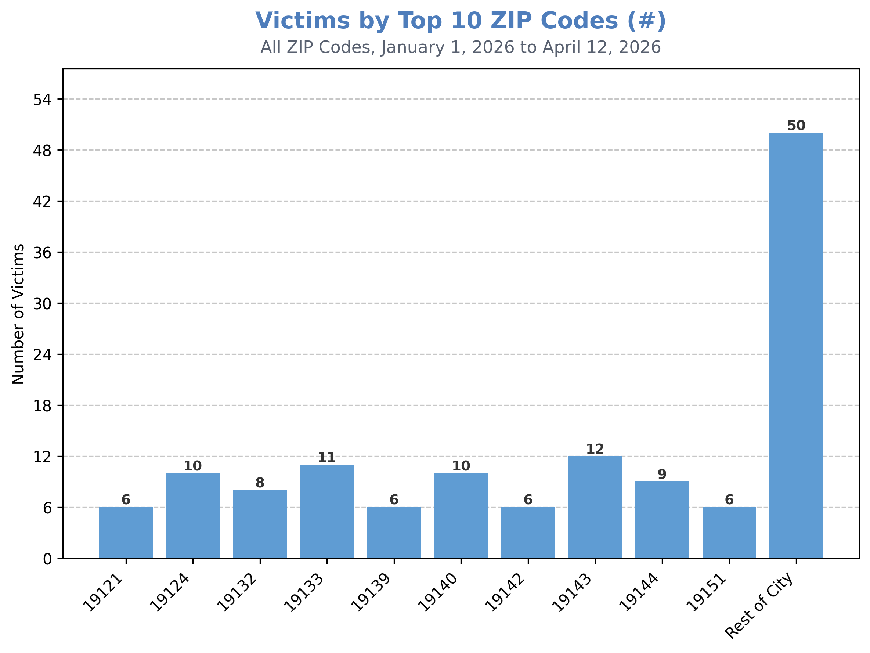
Year-to-date, the 10 ZIP codes with the most shootings have accounted for approximately 63% of all shooting victimization in Philadelphia.
The 19143 ZIP code has accounted for the most victimization, followed by 19133, 19124, 19140, and 19144.

Slide 15
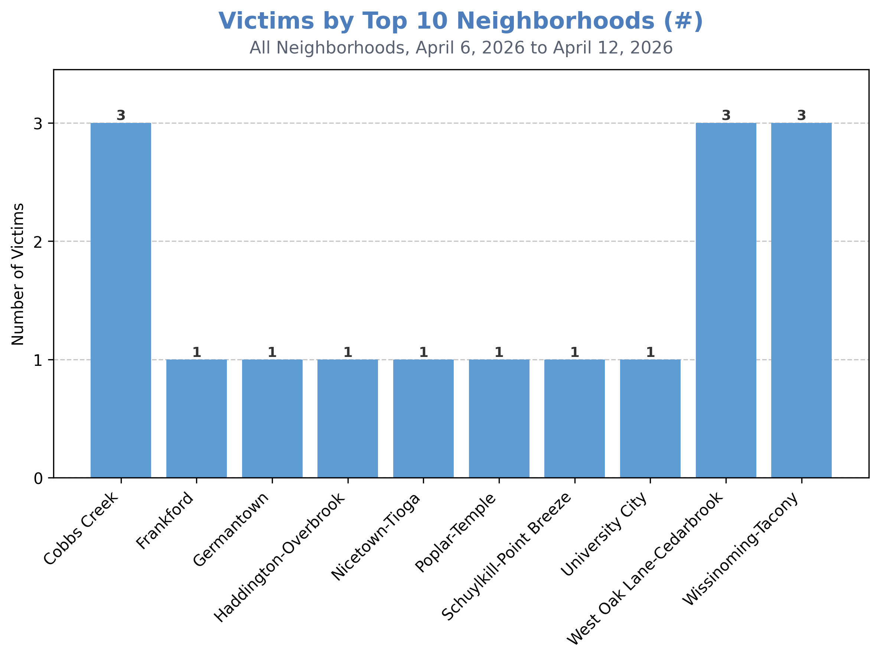
The Cobbs Creek, West Oak Lane-Cedarbrook, and Wissinoming-Tacony neighborhoods all had multiple shooting victims during the week of April 6th.

Slide 16
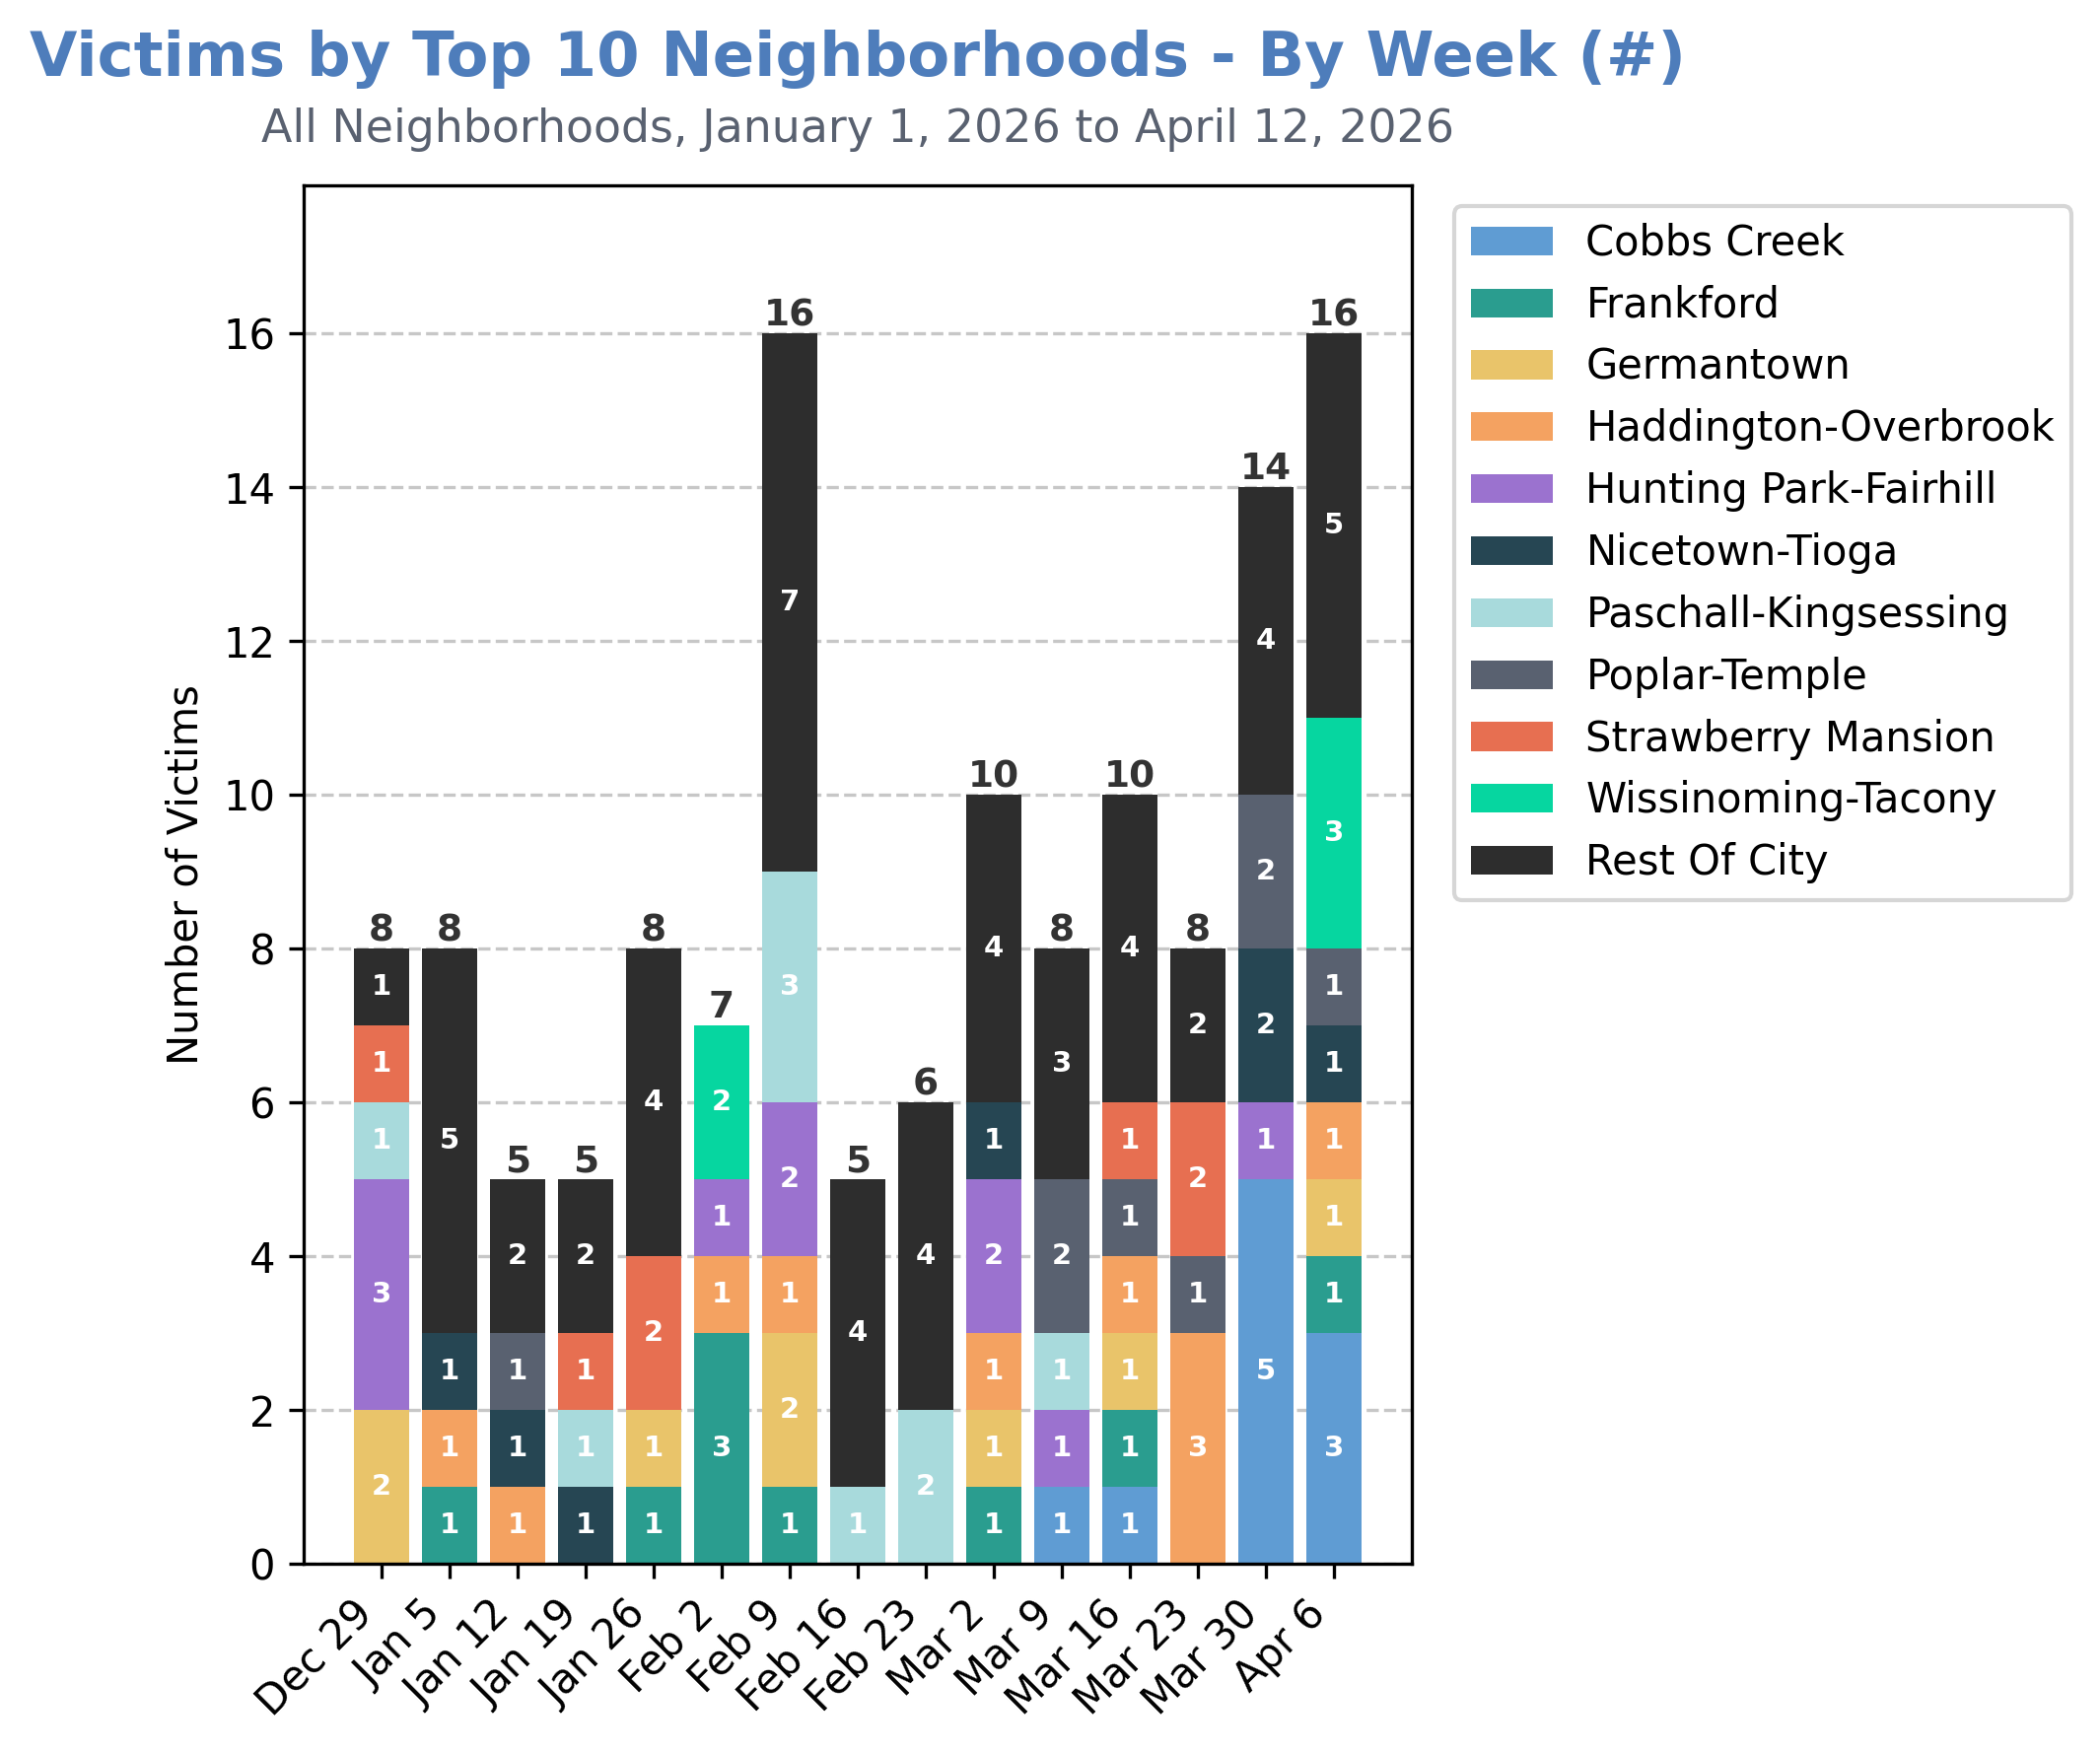
Of the top 10 neighborhoods that have seen the most victimization this calendar year, Cobbs Creek and Wissinoming-Tacony saw the most victimization during the week of April 6th.
This appears to signify a two-week trend, with 8 shooting victims in Cobbs Creek since the week of March 30th.

Slide 17
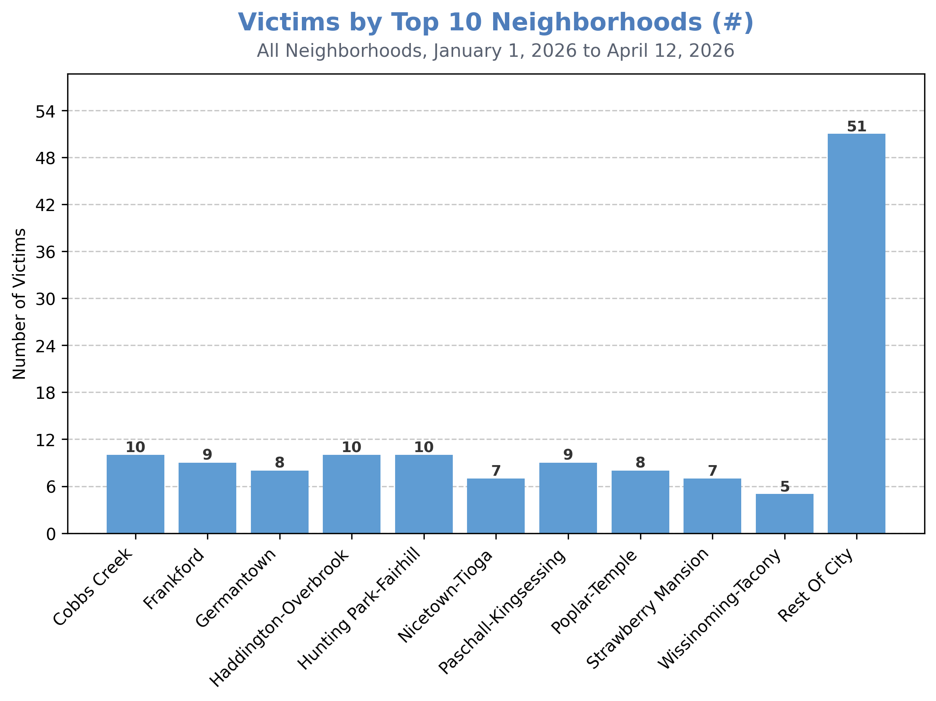
This is a large spike in violence in the Cobbs Creek neighborhood, as there had been a total of 2 shooting victims in Cobbs Creek for the rest of 2026.
The 10 most violent neighborhoods in 2026 have accounted for approximately 62% of all shooting victimization.
Cobbs-Creek, Haddington-Overbrook, and Hunting Park-Fairhill have seen the most victimization (n:10).

Slide 18
Note: the Sharswood-Stanton, Northern Liberties-West Kensington, & Oxford Circle neighborhoods have had the same number of shooting victims as Wissinoming-Tacony (5).
Future reports will explore more complete visualizations of “Top 10” areas.

Slide 19
Time & Day Details

Slide 20
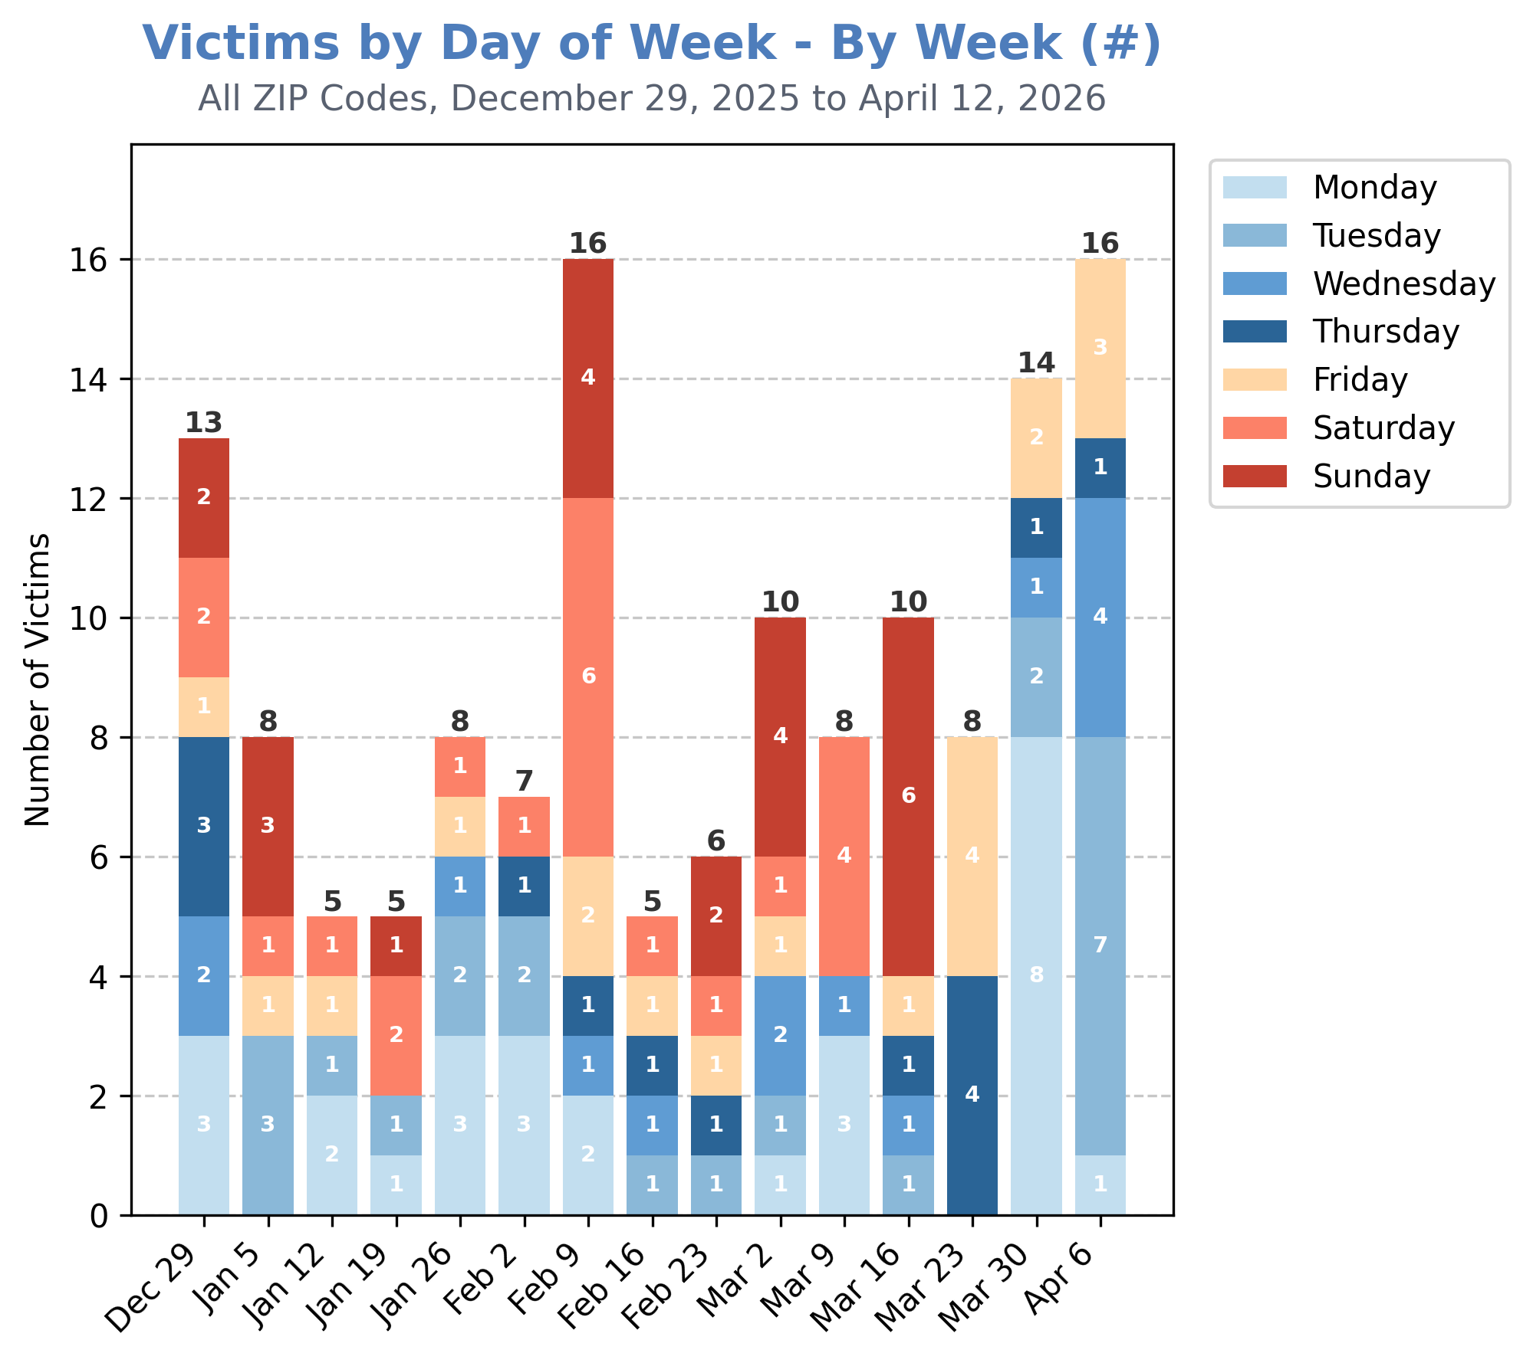
13 of 16 shooting victims during the week of April 6th were shot during the weekdays of Monday – Thursday.
The most (7) were shot on Tuesdays. This is largely due to the two (2) 3-victim shooting incidents on Tuesday, April 7th.

Slide 21
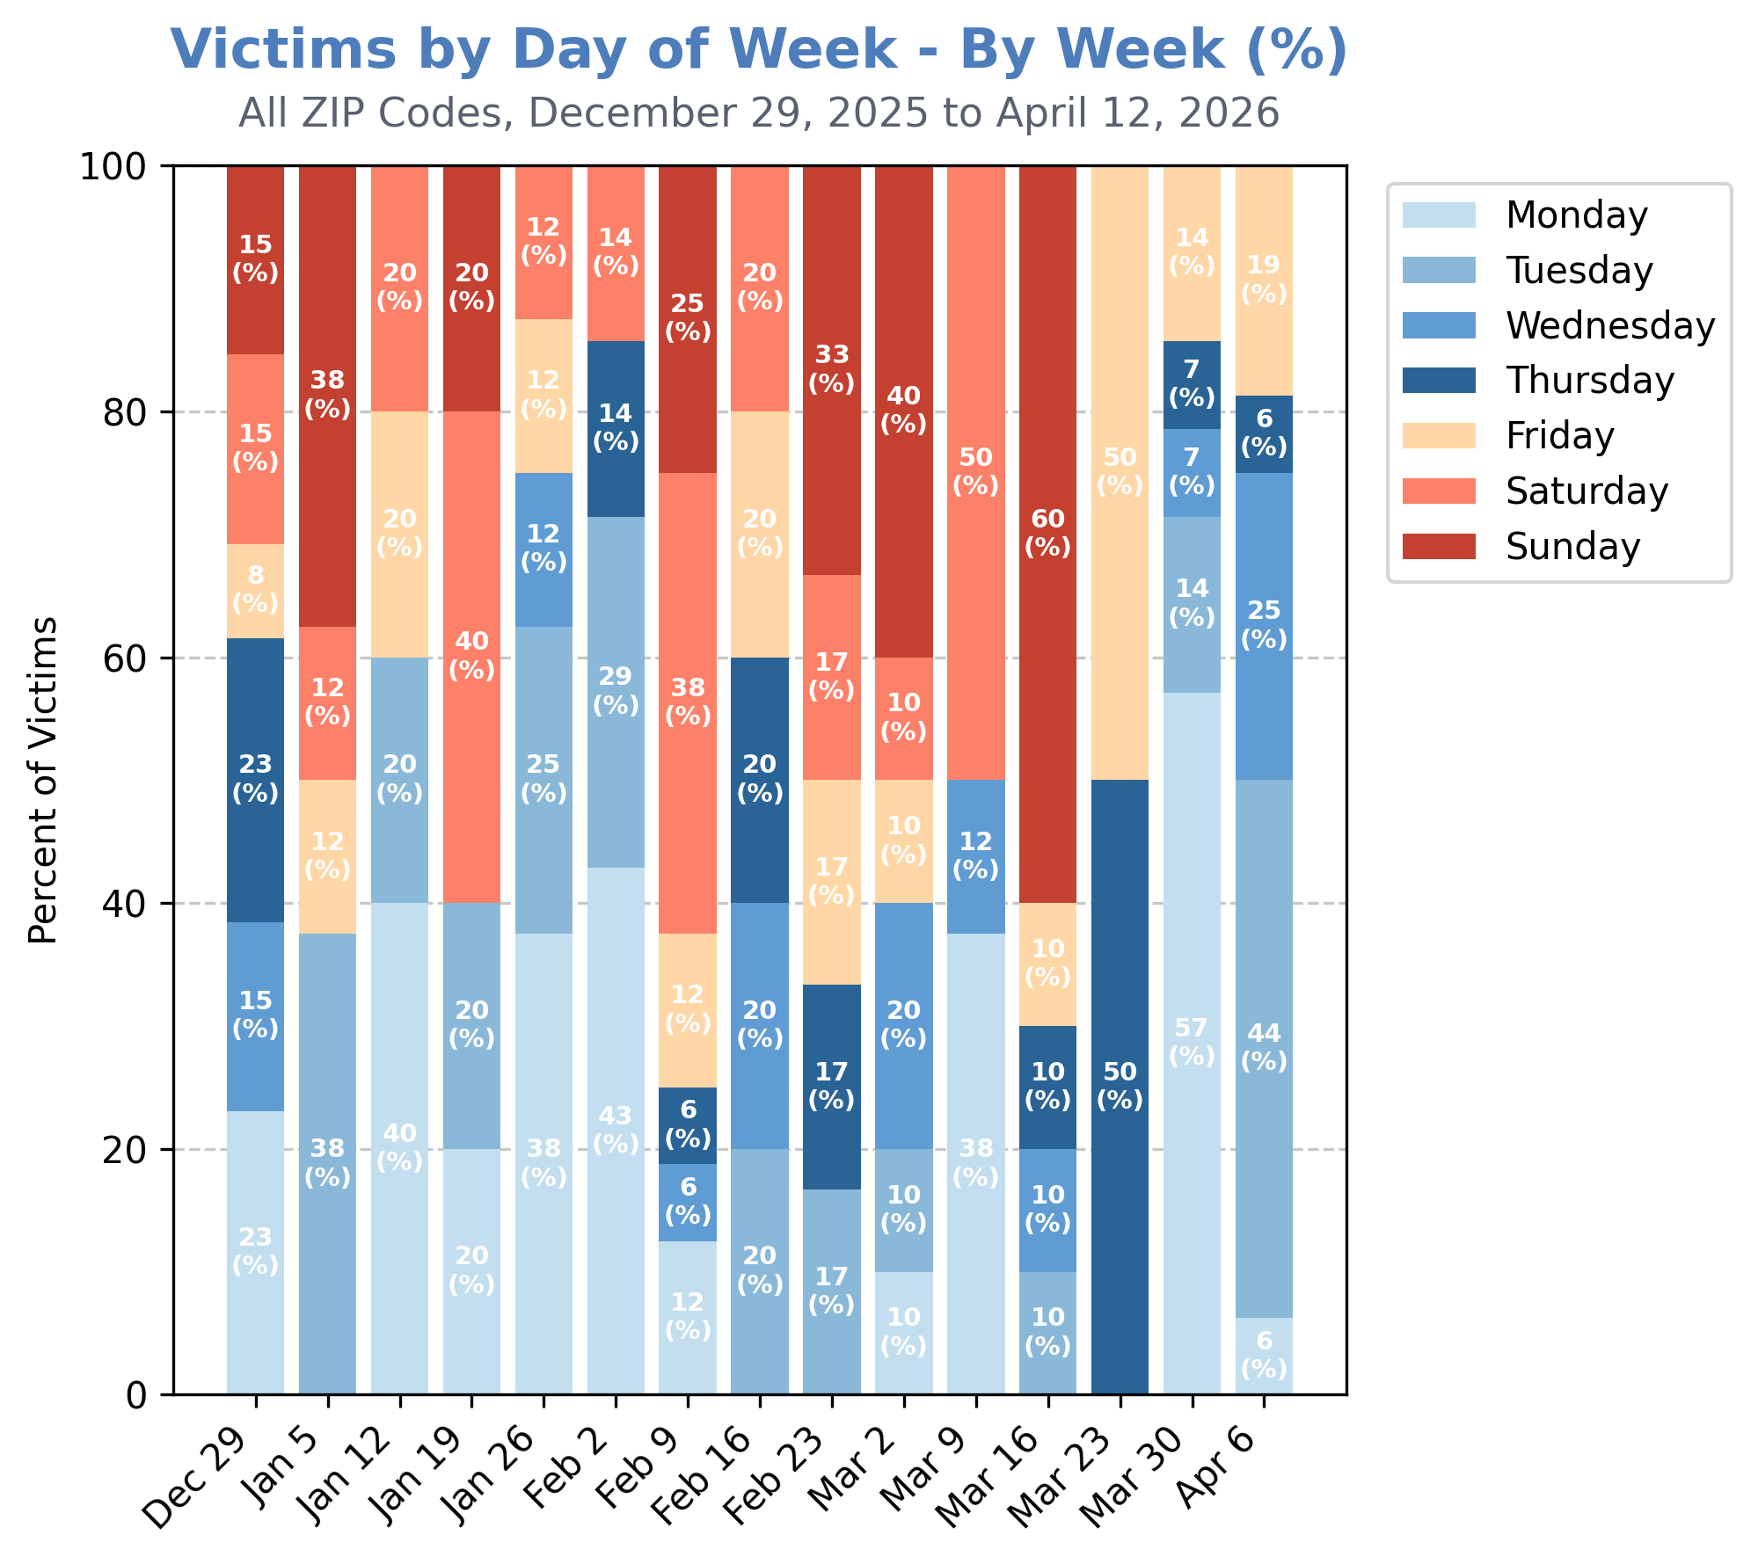
This marks a two-week trend where less than 20% of shooting victims were shot on Fridays – Sundays.

Slide 22
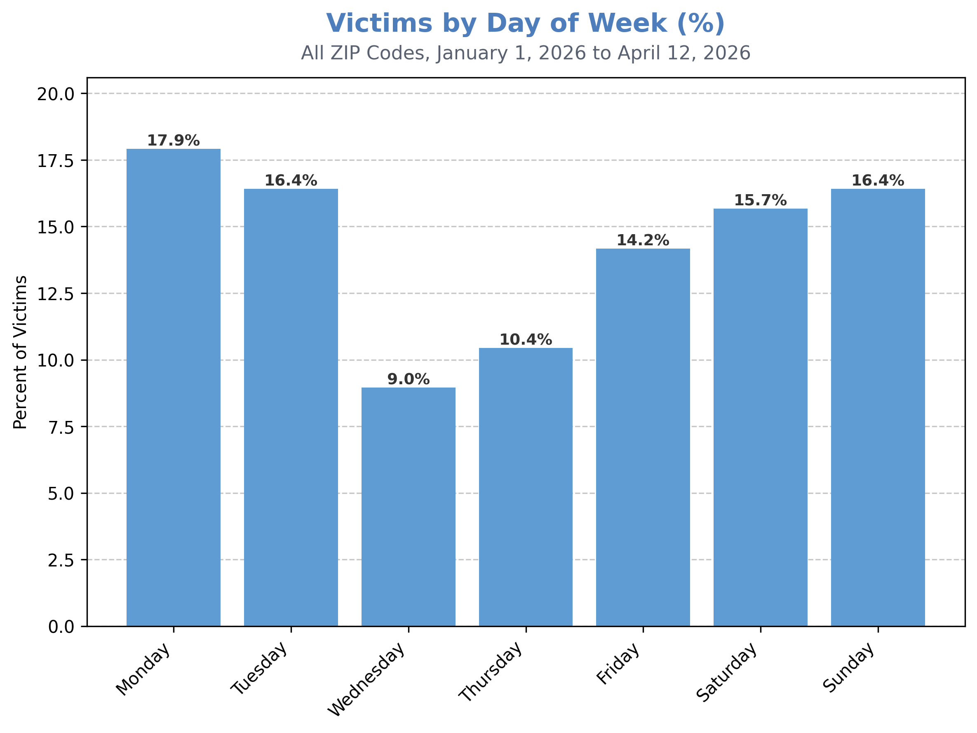
Year-to-date, approximately 46% of shooting victimization has occurred on Friday – Sunday, while approximately 54% has occurred on Monday – Thursday.
The most victims (18%) have been shot on Mondays.

Slide 23
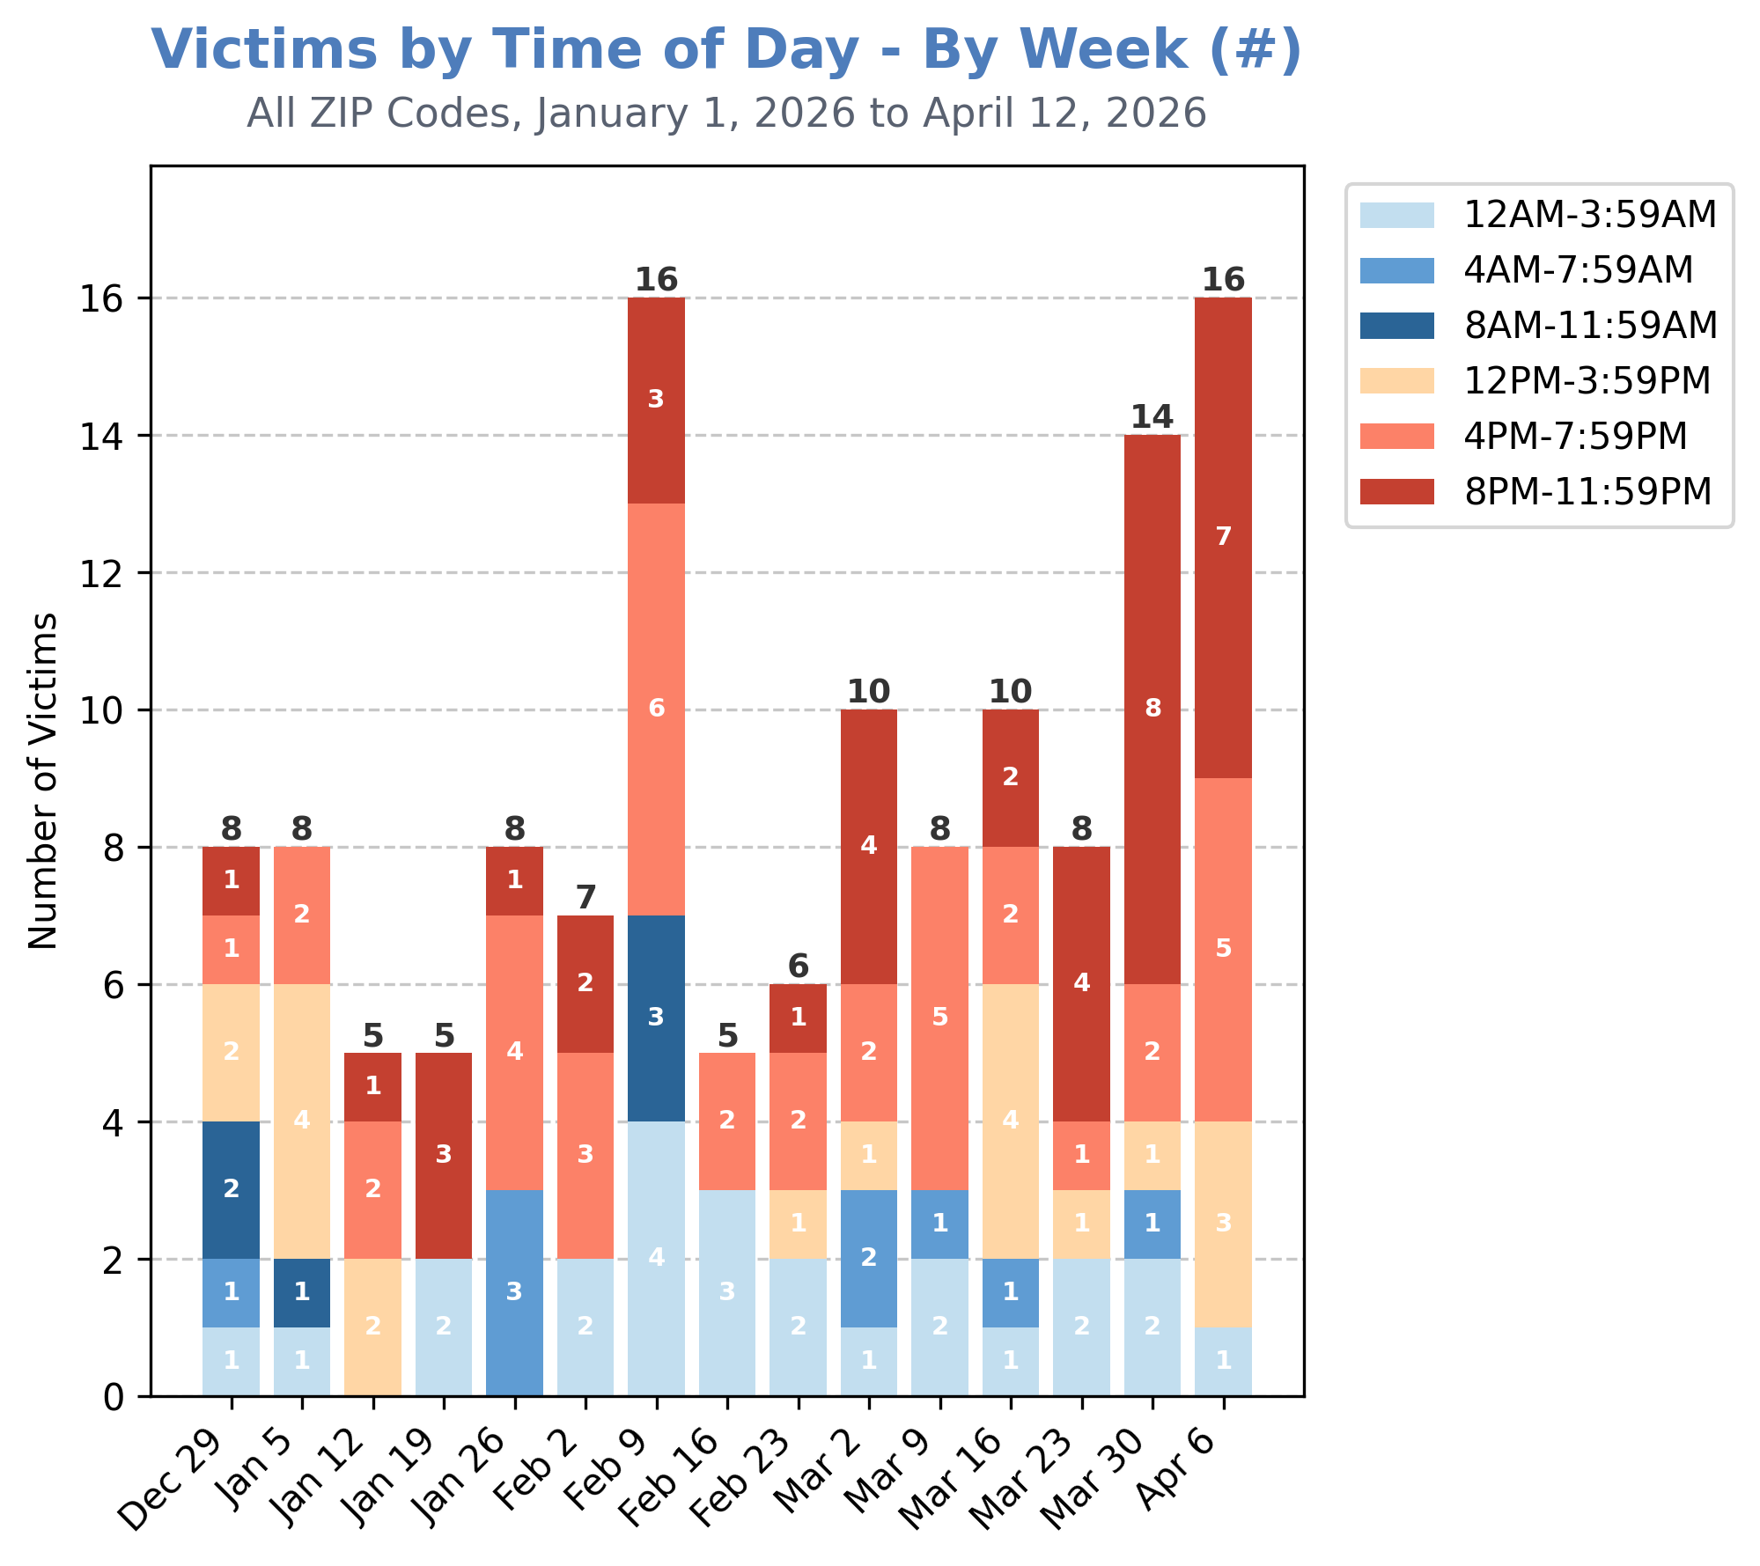
12 of 16 shooting victims (75%) on the week of April 6th were shot between the hours of 4:00 PM and 11:59 PM.

Slide 24
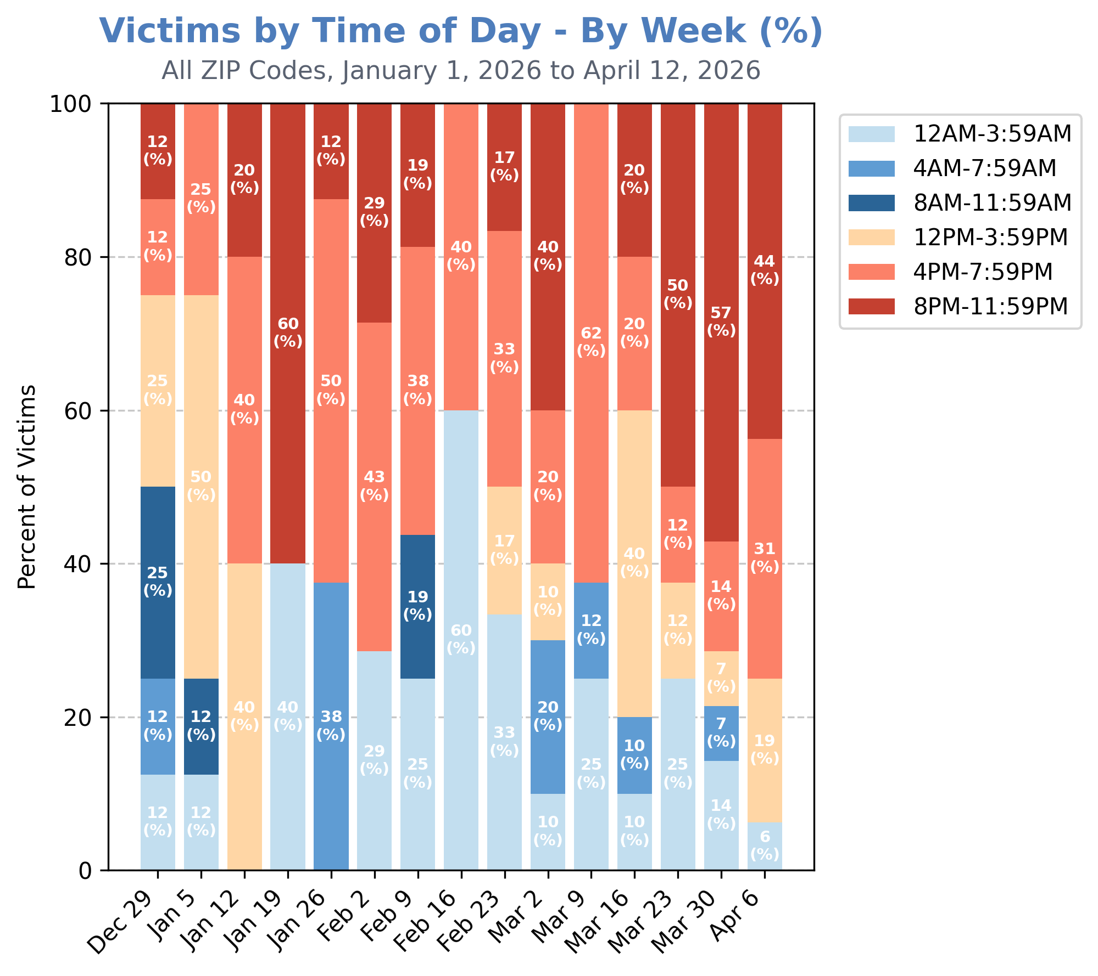
This marks a similar trend from the previous week, where 10 of 14 (71%) of victims were shot between the hours of 4:00 PM and 11:59 PM.

Slide 25
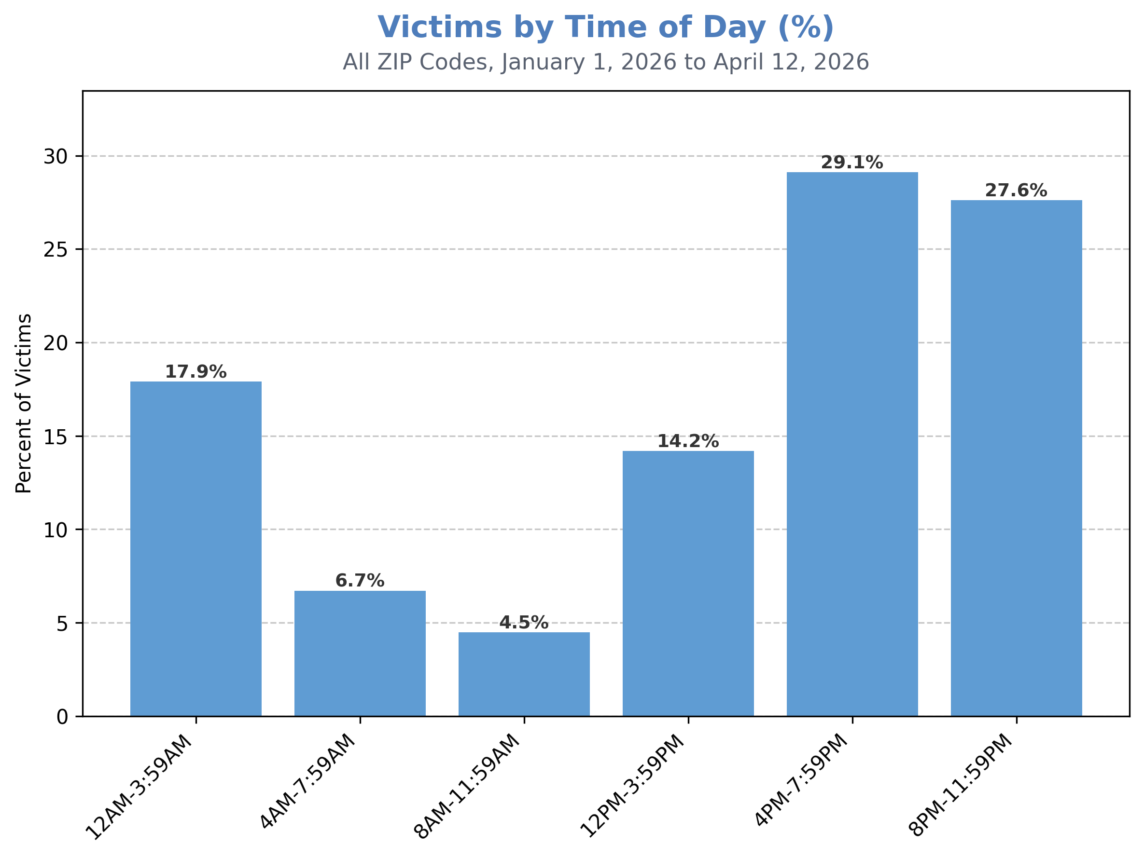
For the calendar year to date, the time windows of
4:00 PM – 7:59 PM and
8:00 PM – 11:59 PM have seen by far the most shootings, accounting for approximately 57% of all shooting victimization.

Slide 26
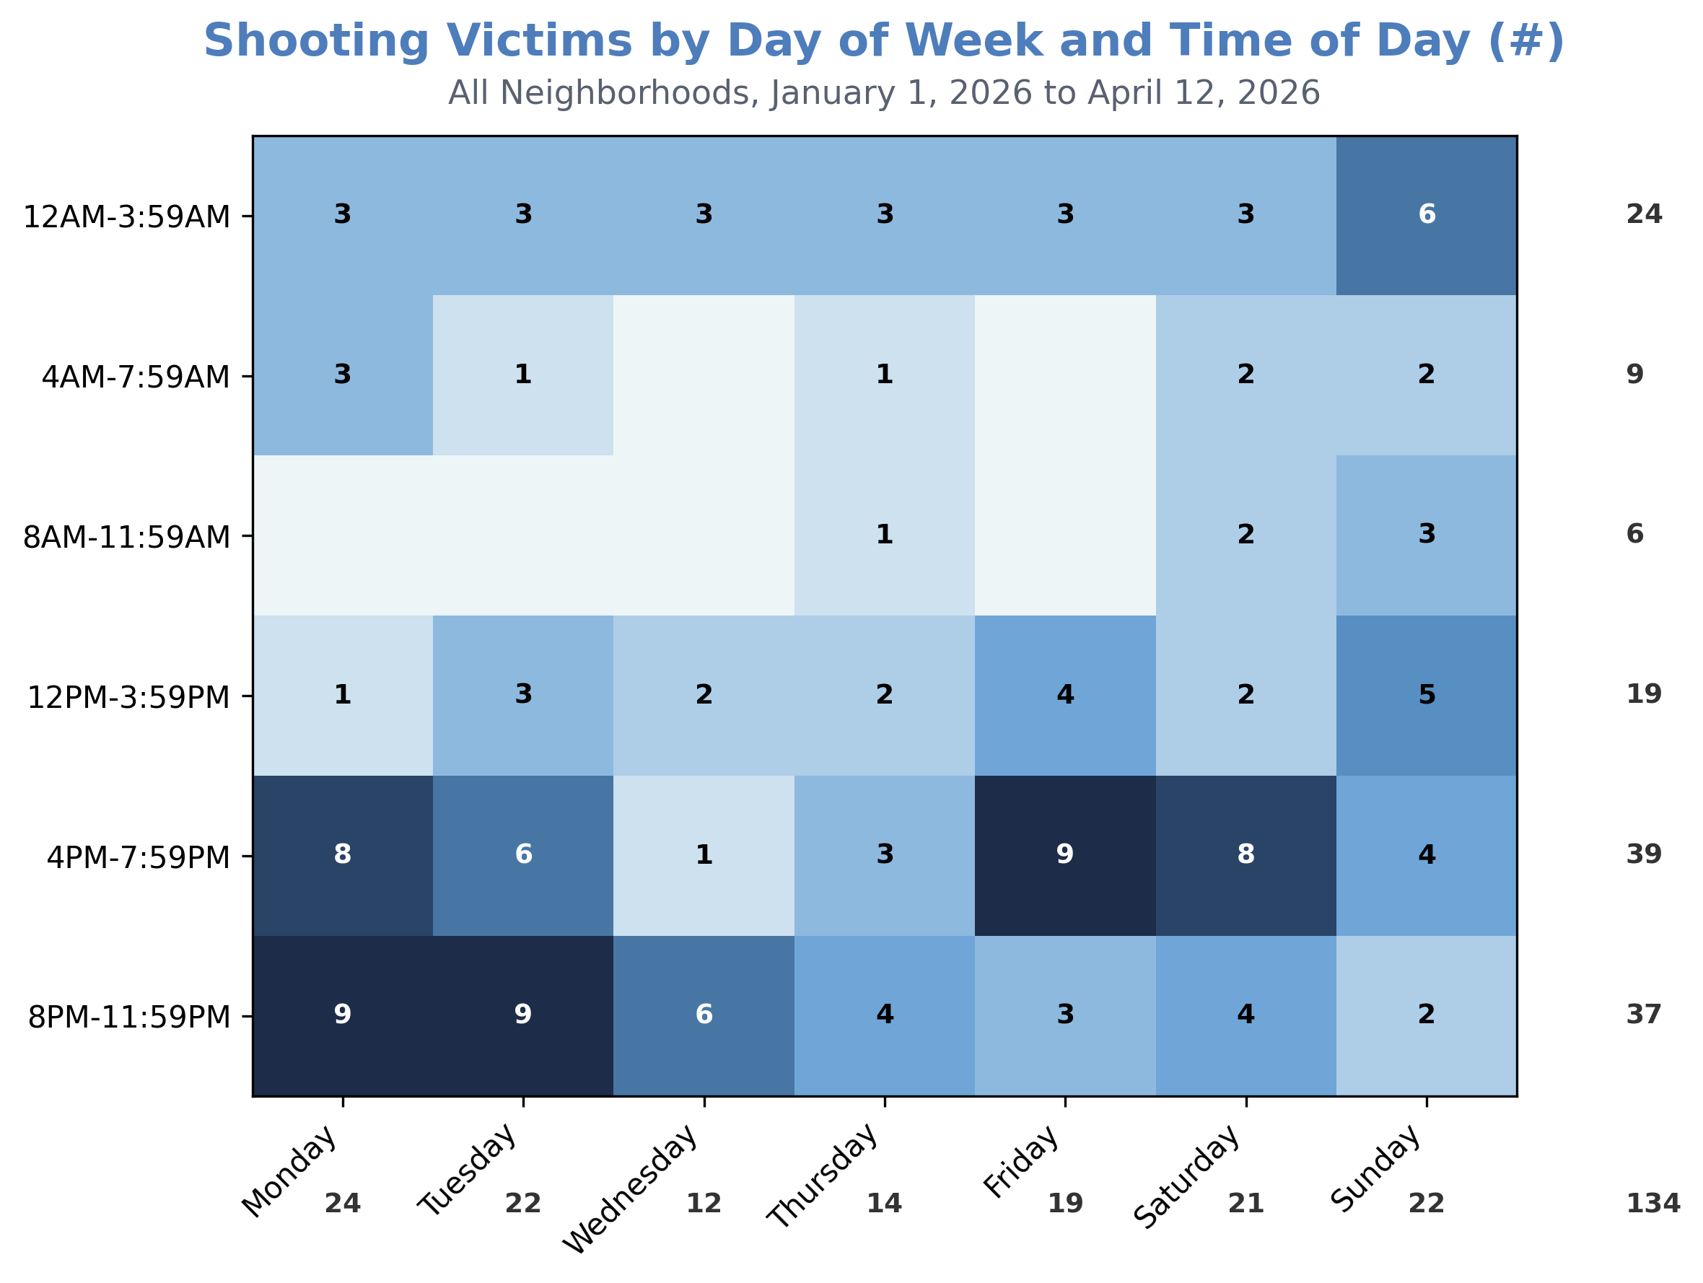
This visual shows that Monday and Tuesday late-afternoon and evening hours have seen the most firearm victimization this calendar year.

Slide 27
Victim Details

Slide 28
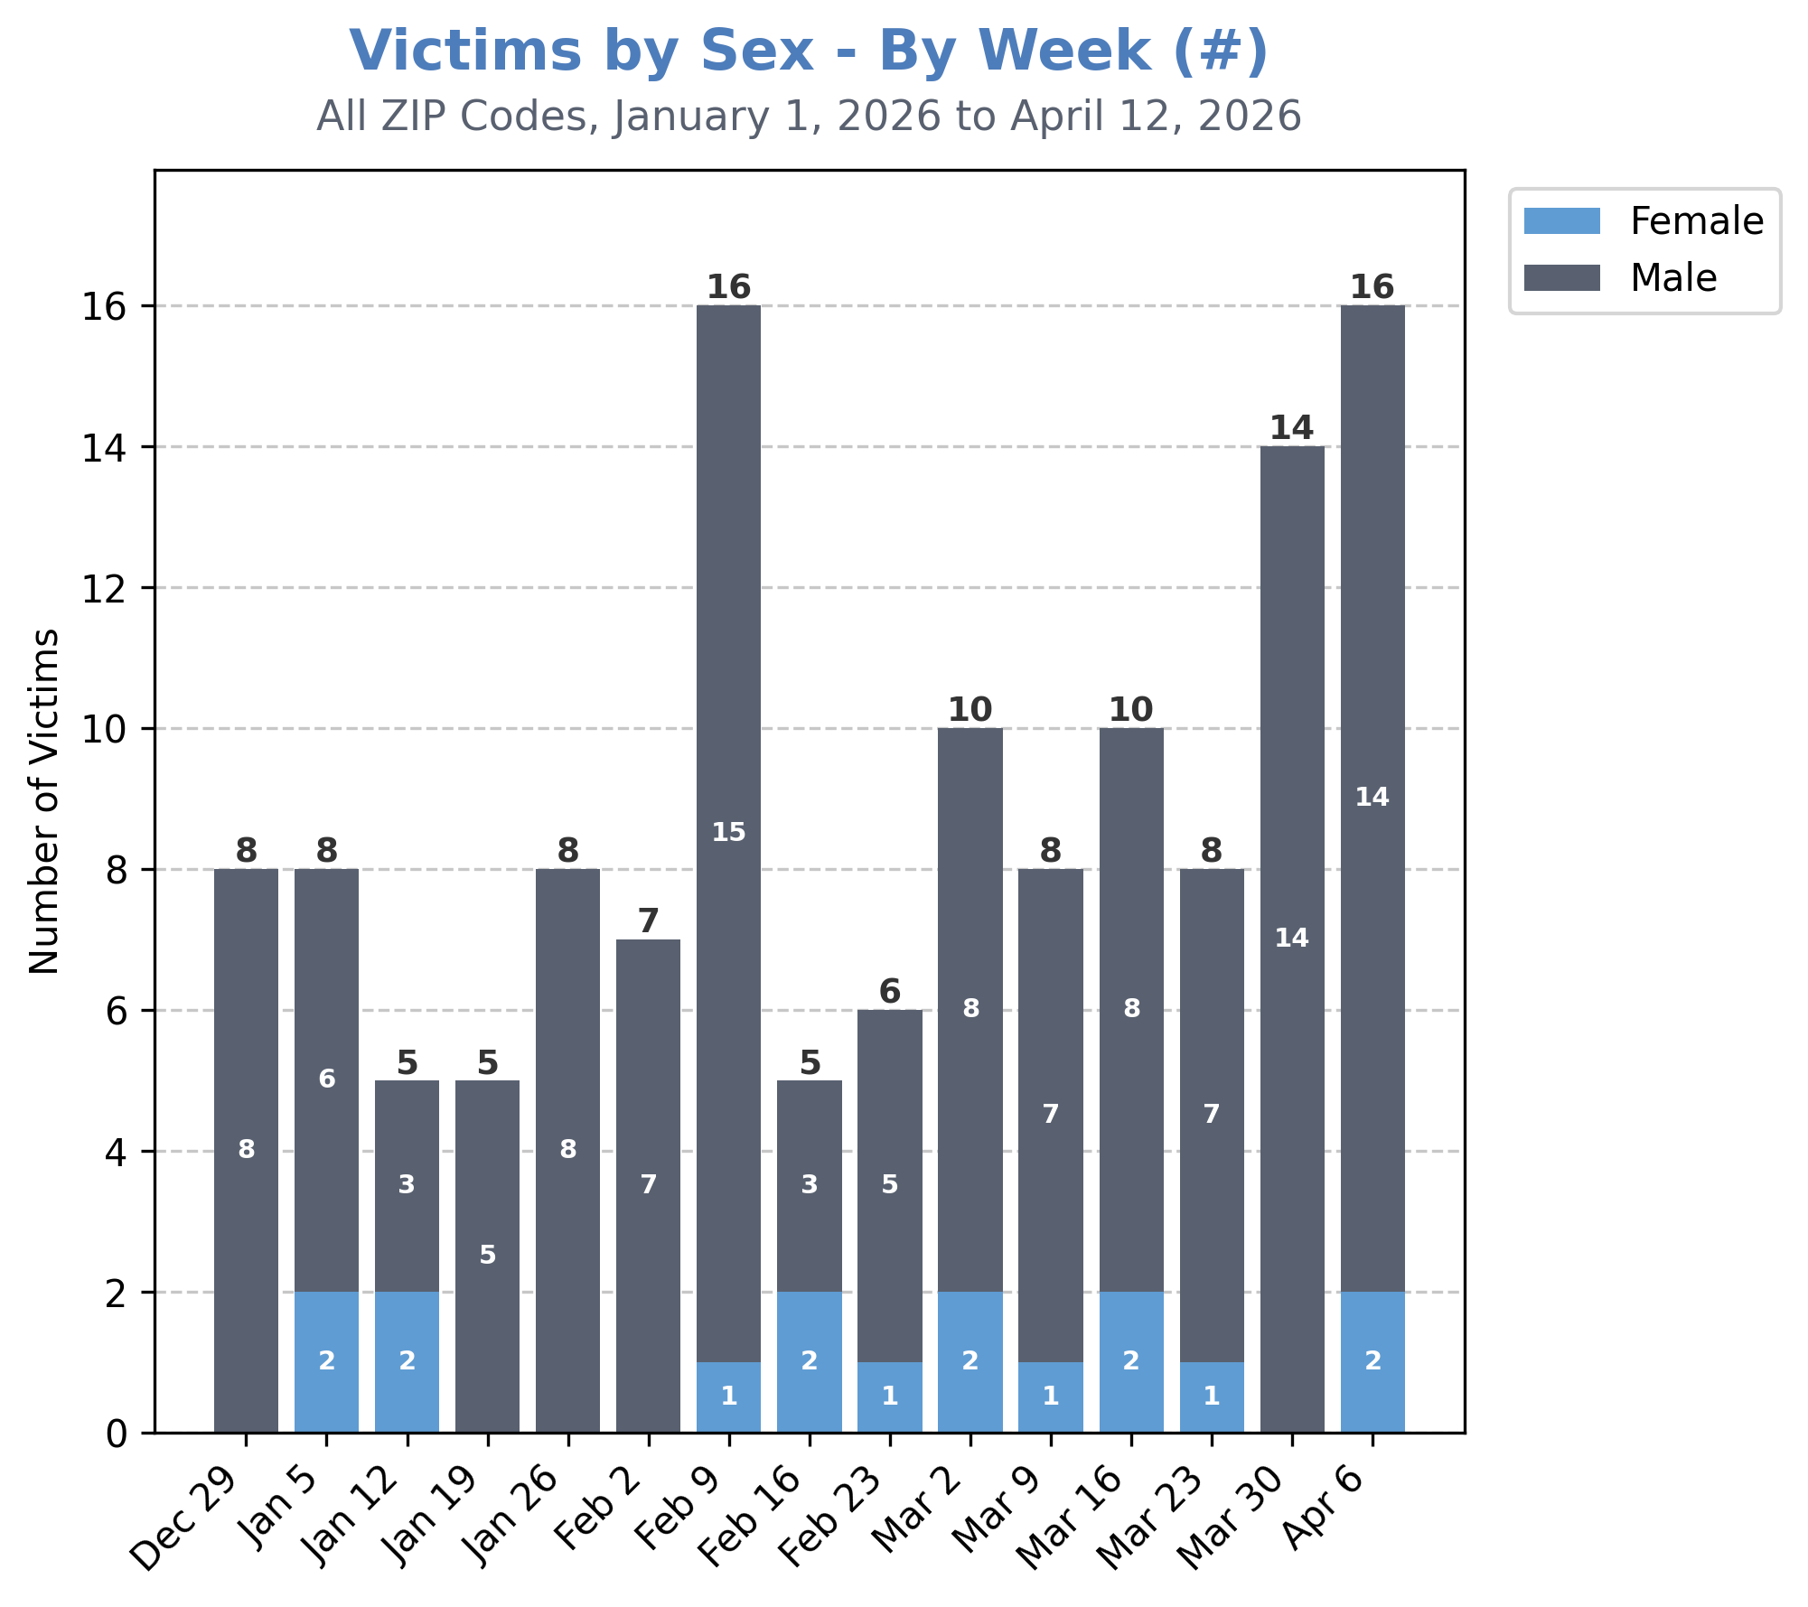
A large majority of shooting victims during the week of April 6th were male (14 of 16).

Slide 29
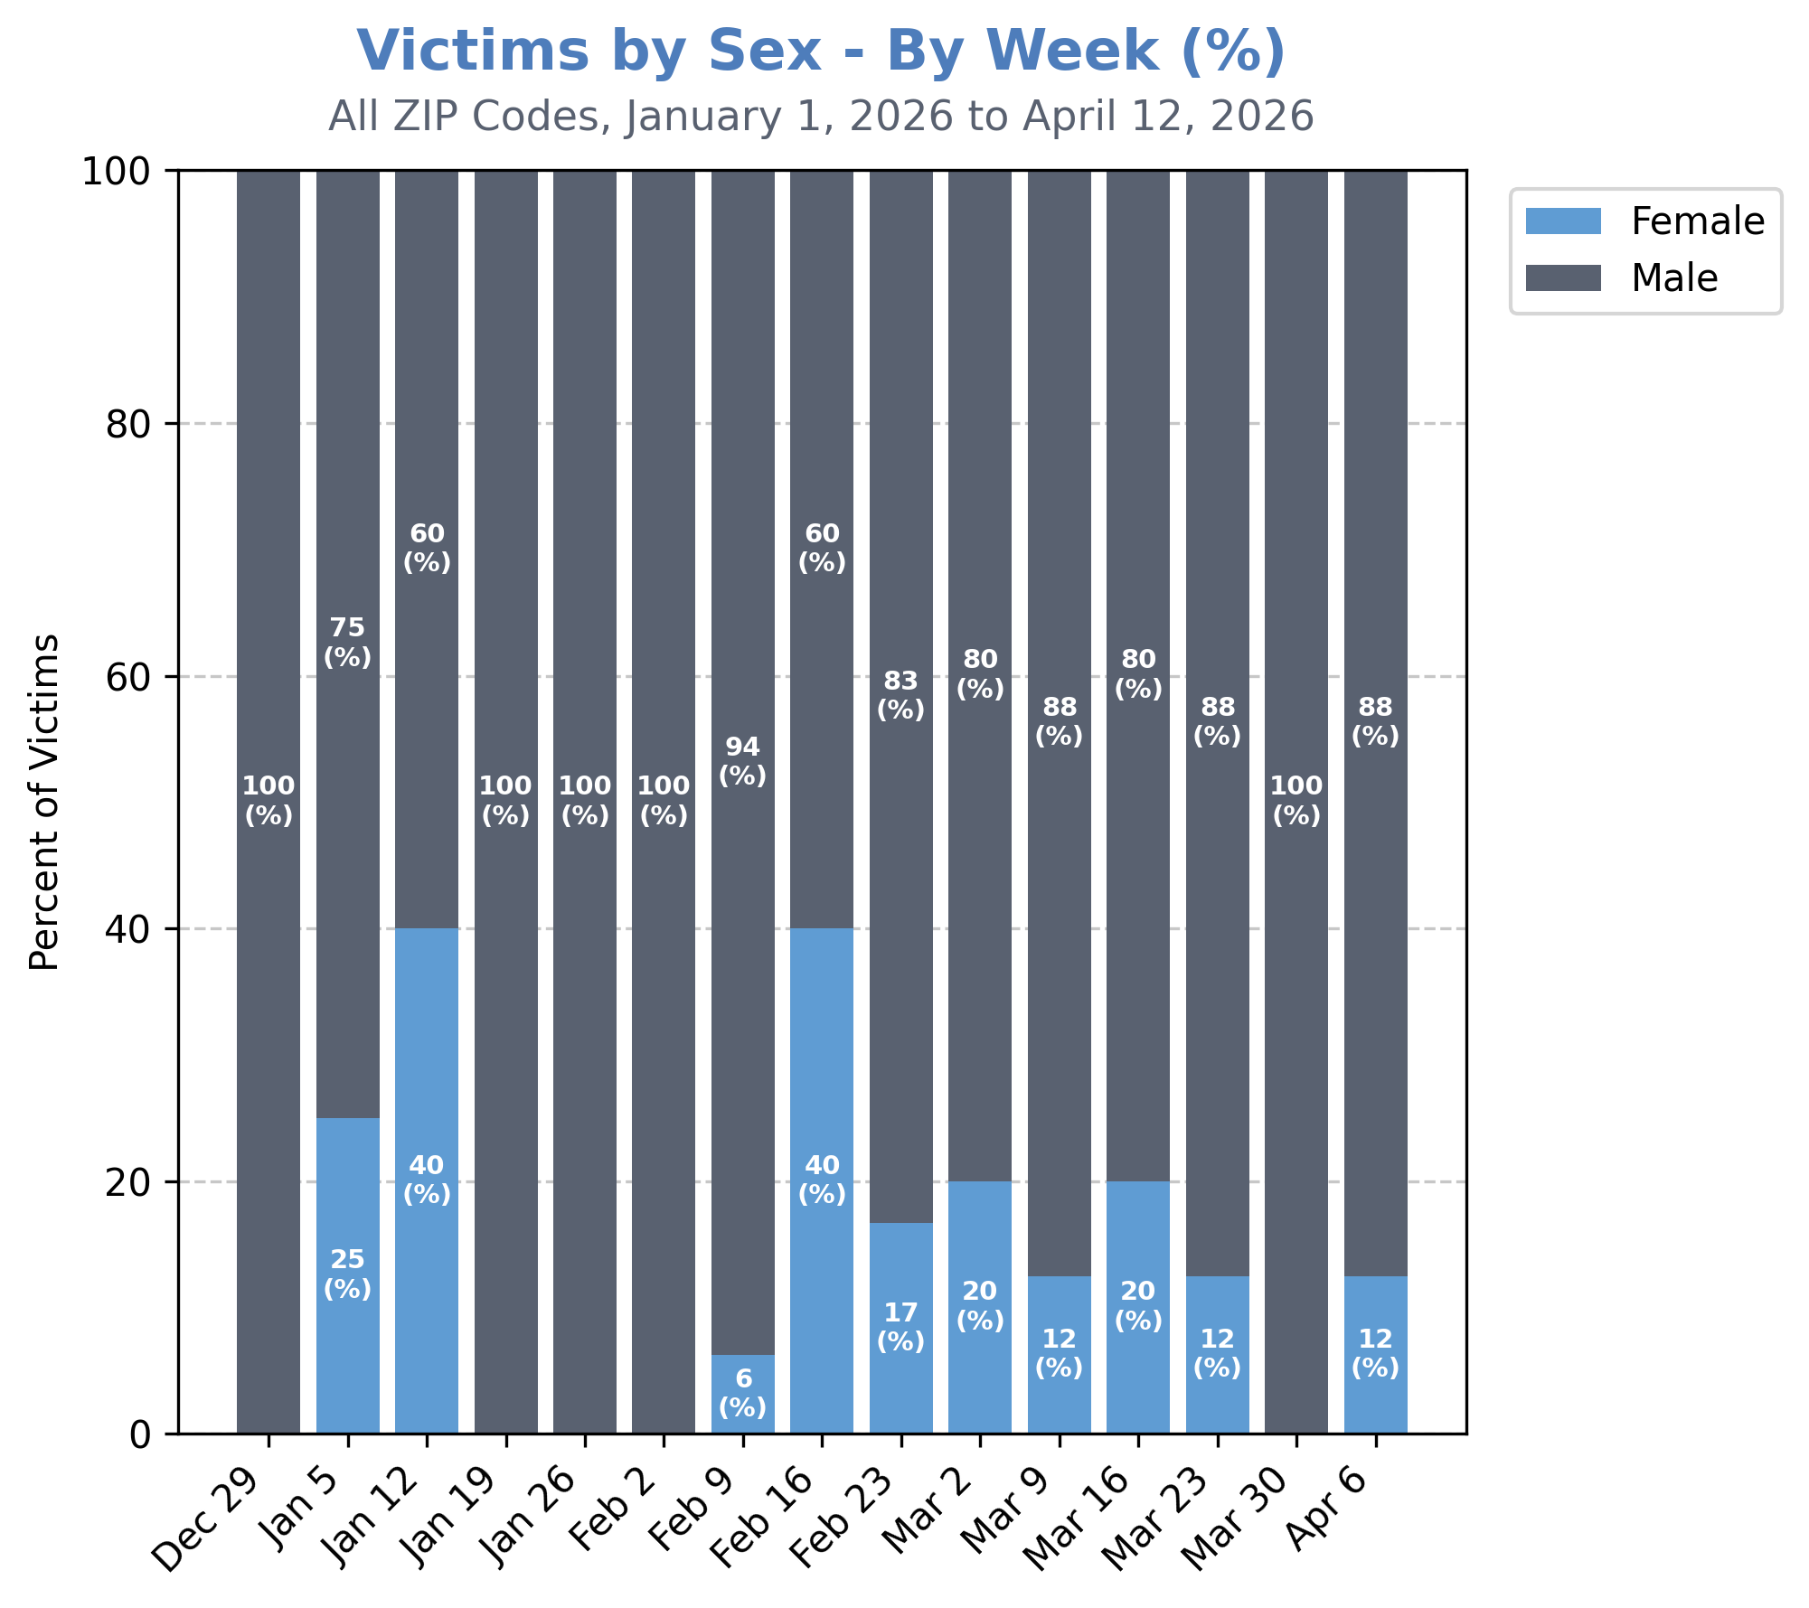
This matches most weekly trends.
Notably, weeks where a greater percentage of shooting victims appear to be female were not driven by a spike in total female shooting victims, but a decrease in male shooting victims (see previous slide).

Slide 30
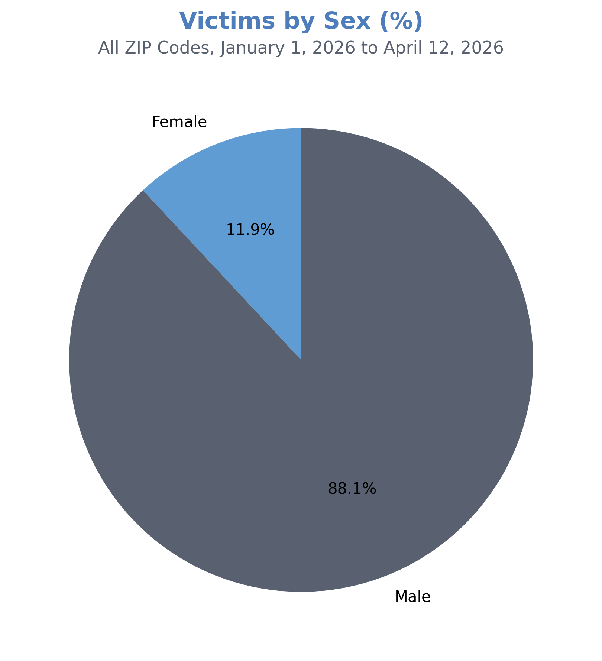
Year-to-date, nearly 9 of 10 shooting victims have been male (88%).

Slide 31
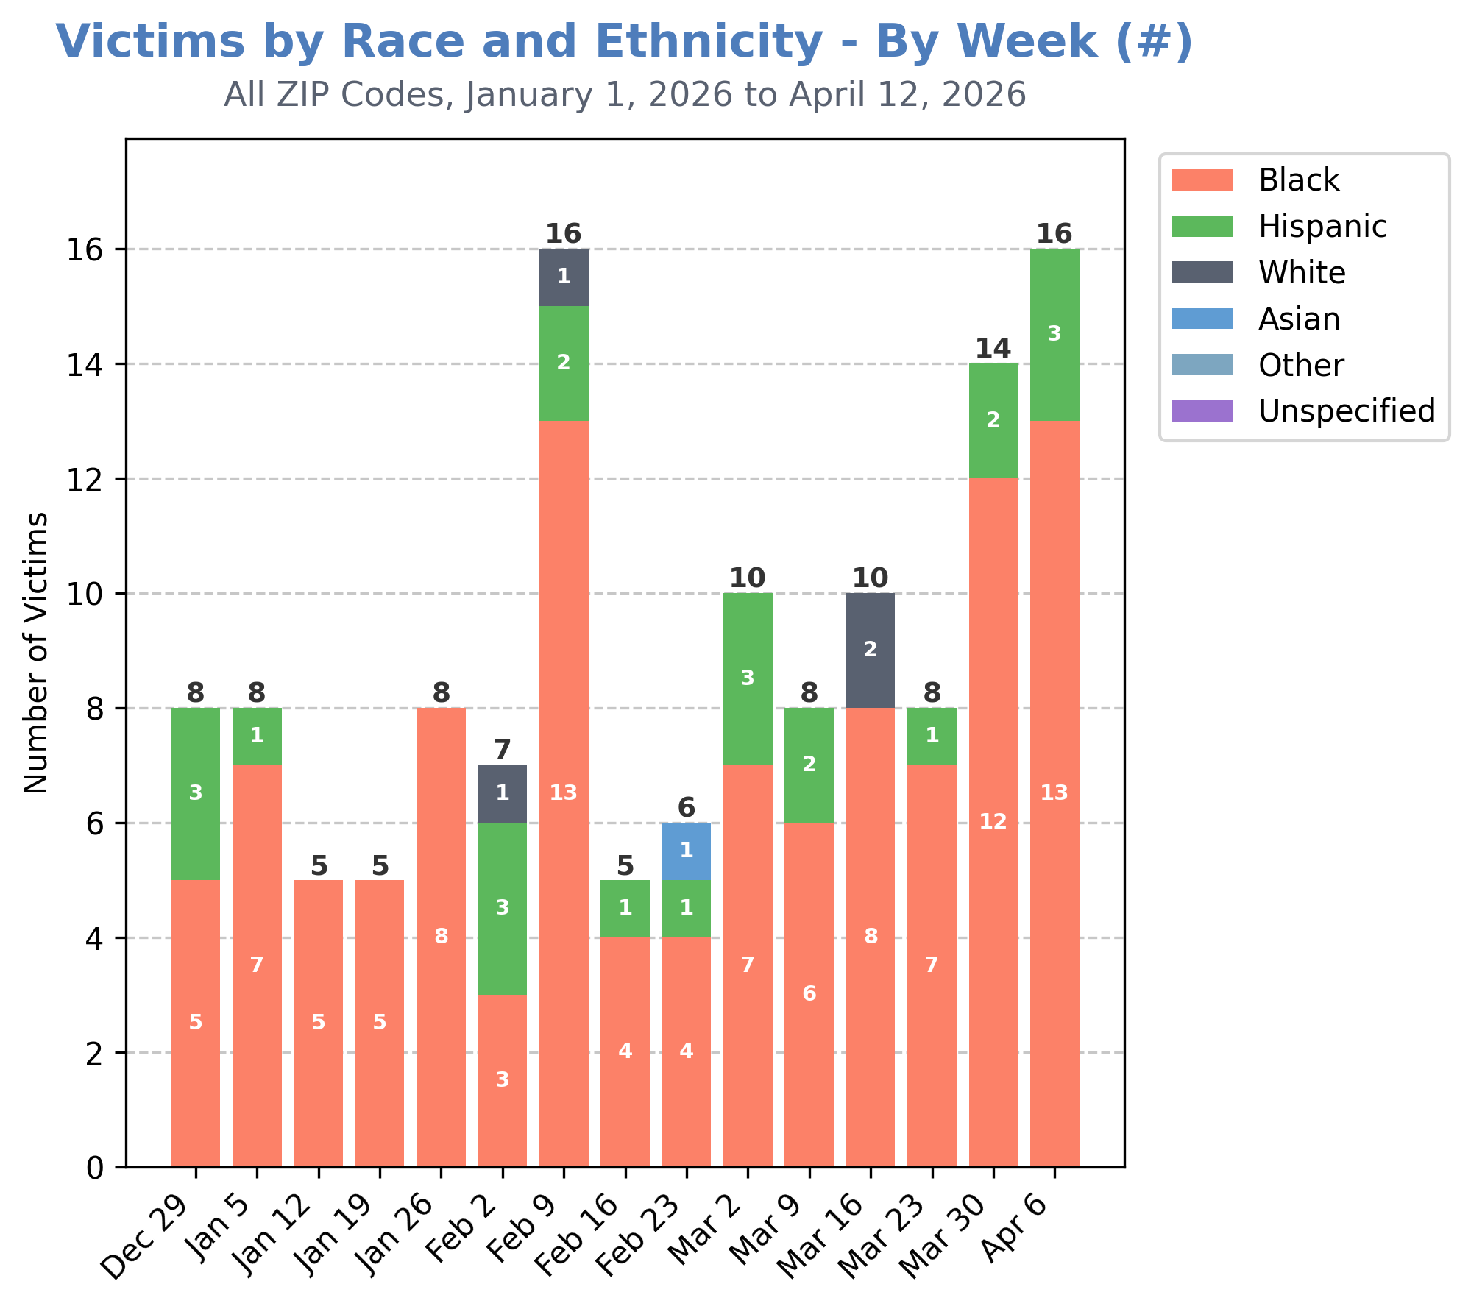
As in most weeks this calendar year, a large majority of shooting victims during the week of April 6th were Black (13 of 16).

Slide 32
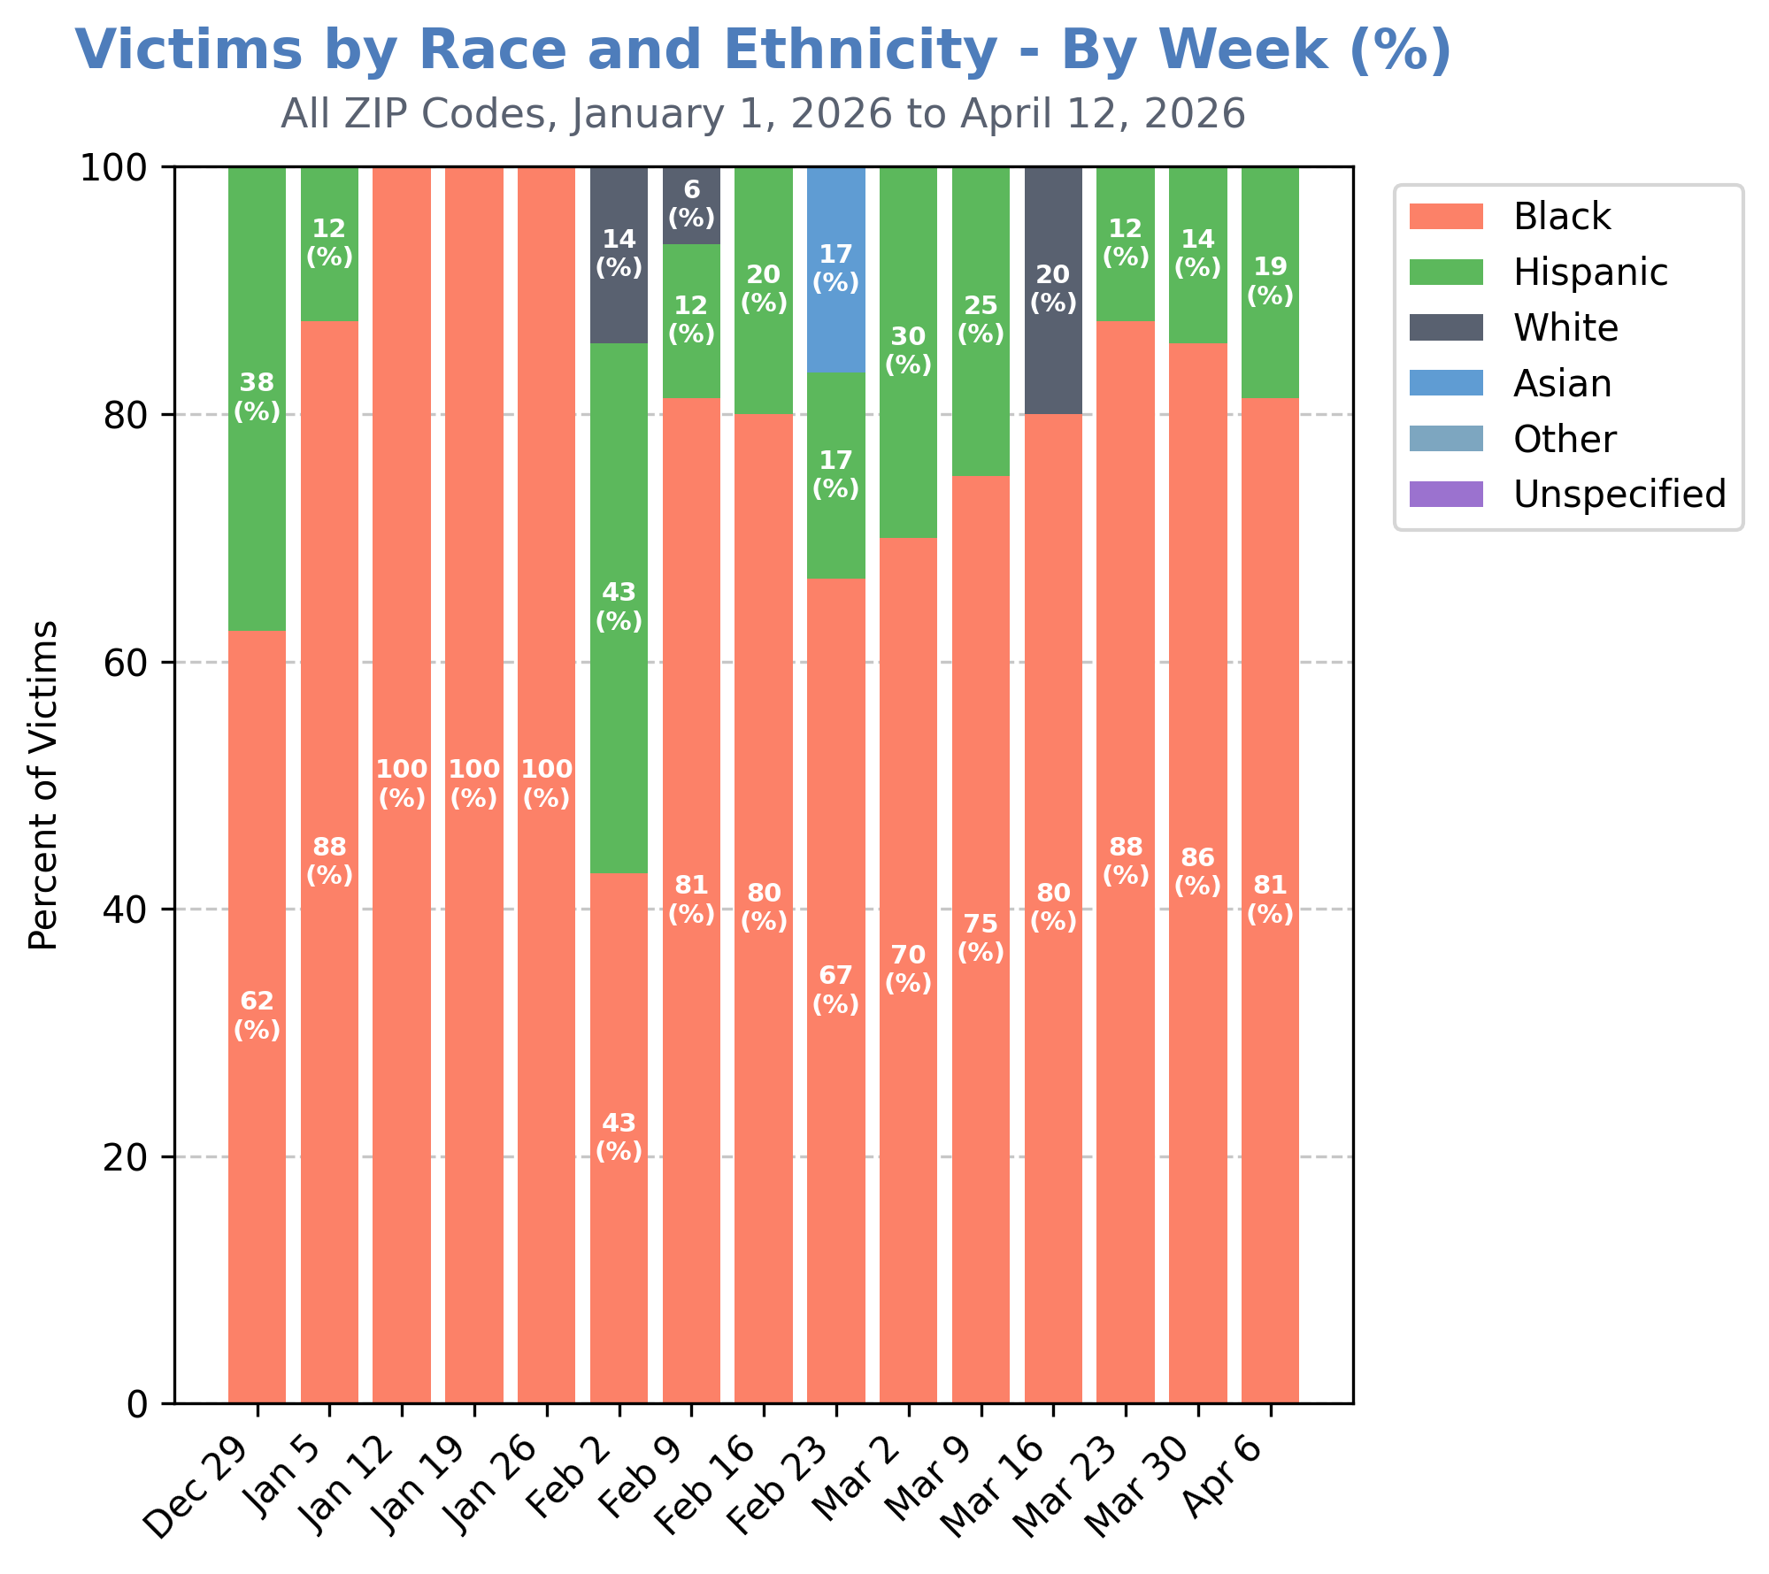
This equates to approximately 81% of shooting victims for the week of April 6th.

Slide 33
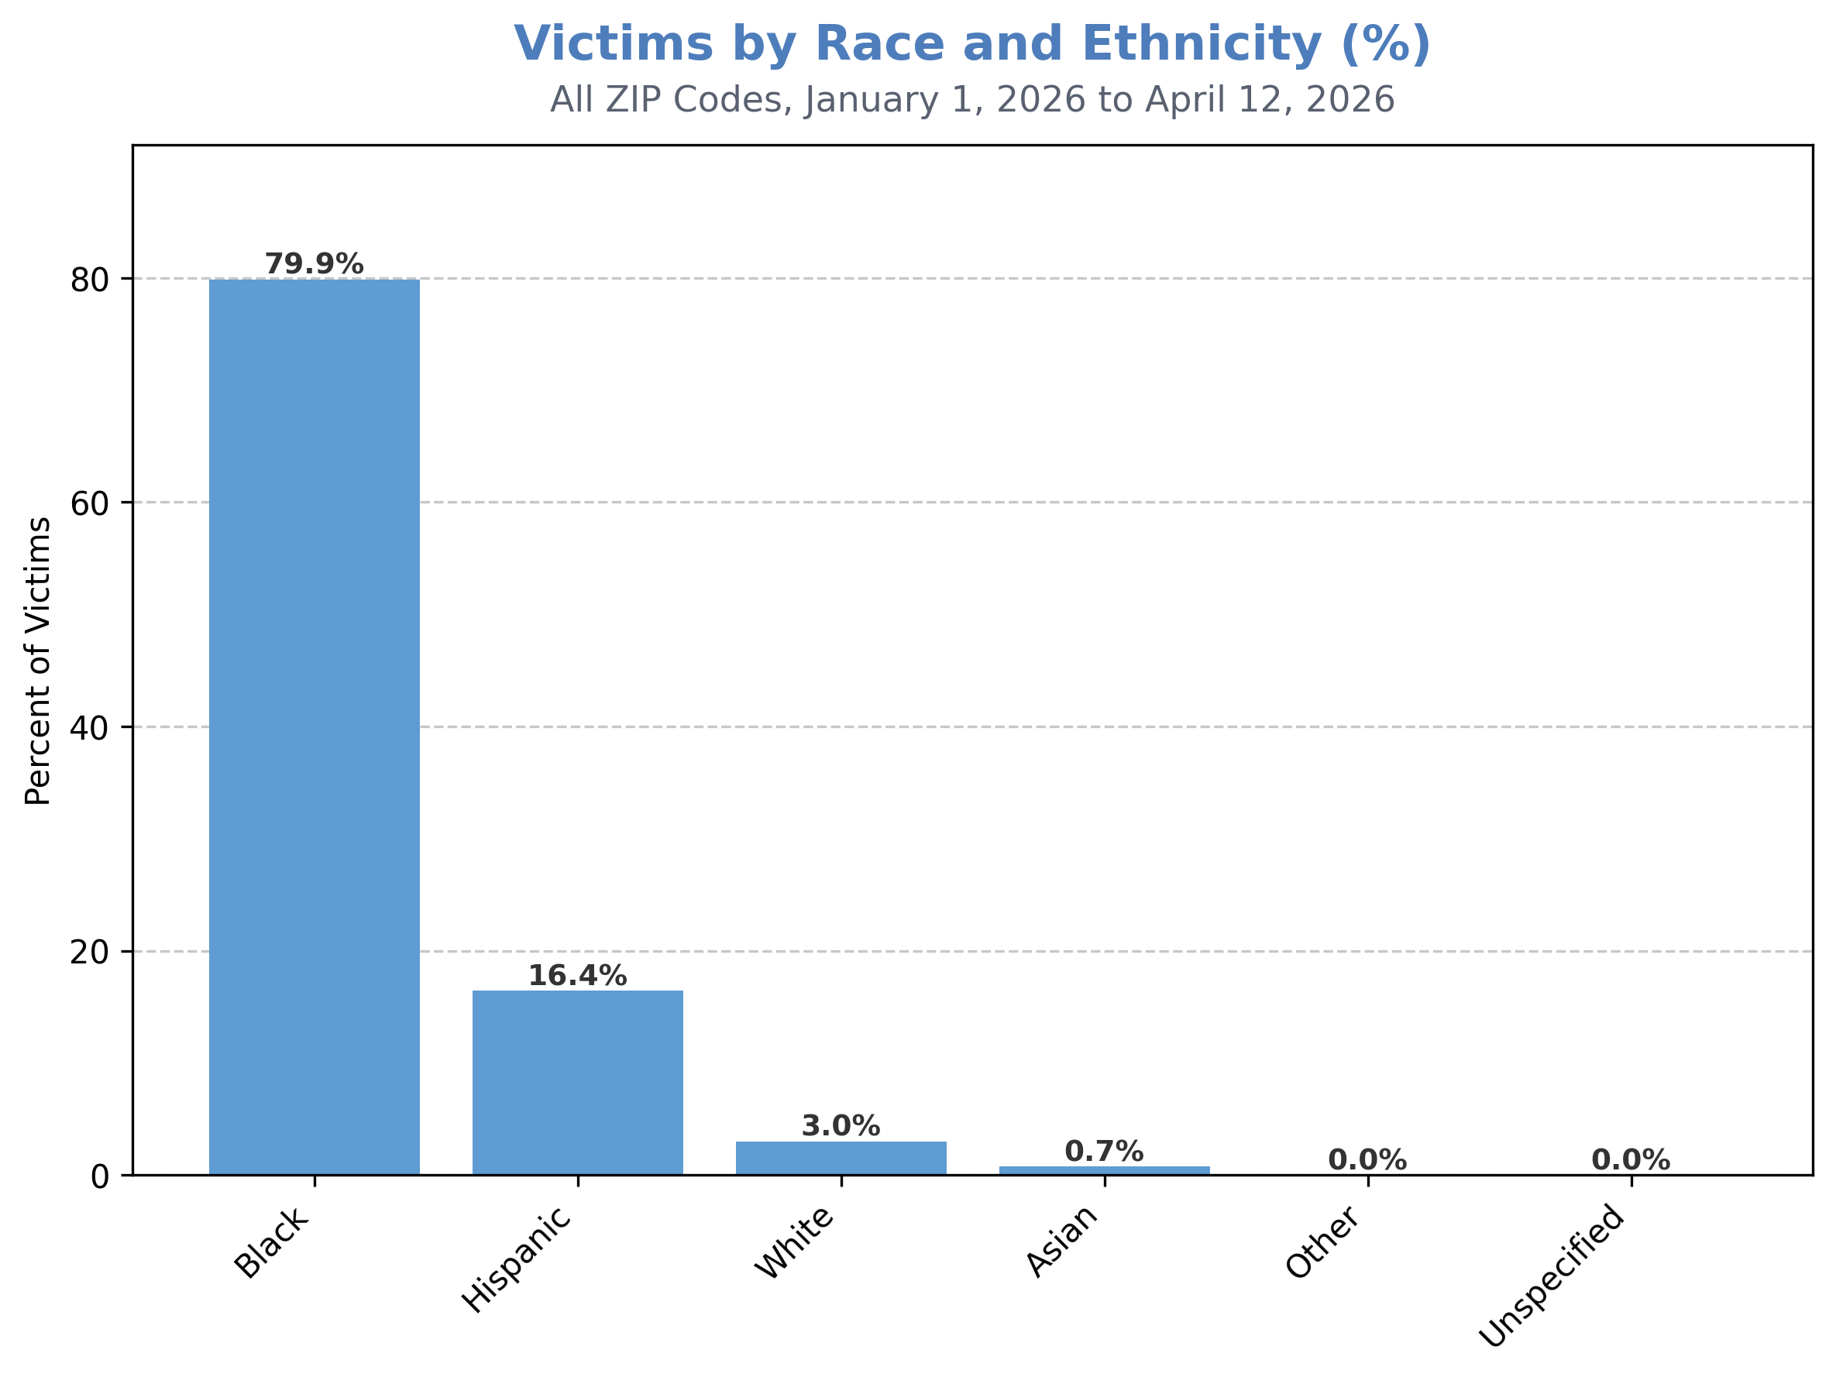
Year-to-date, 8 of 10 shooting victims have been Black.

Slide 34
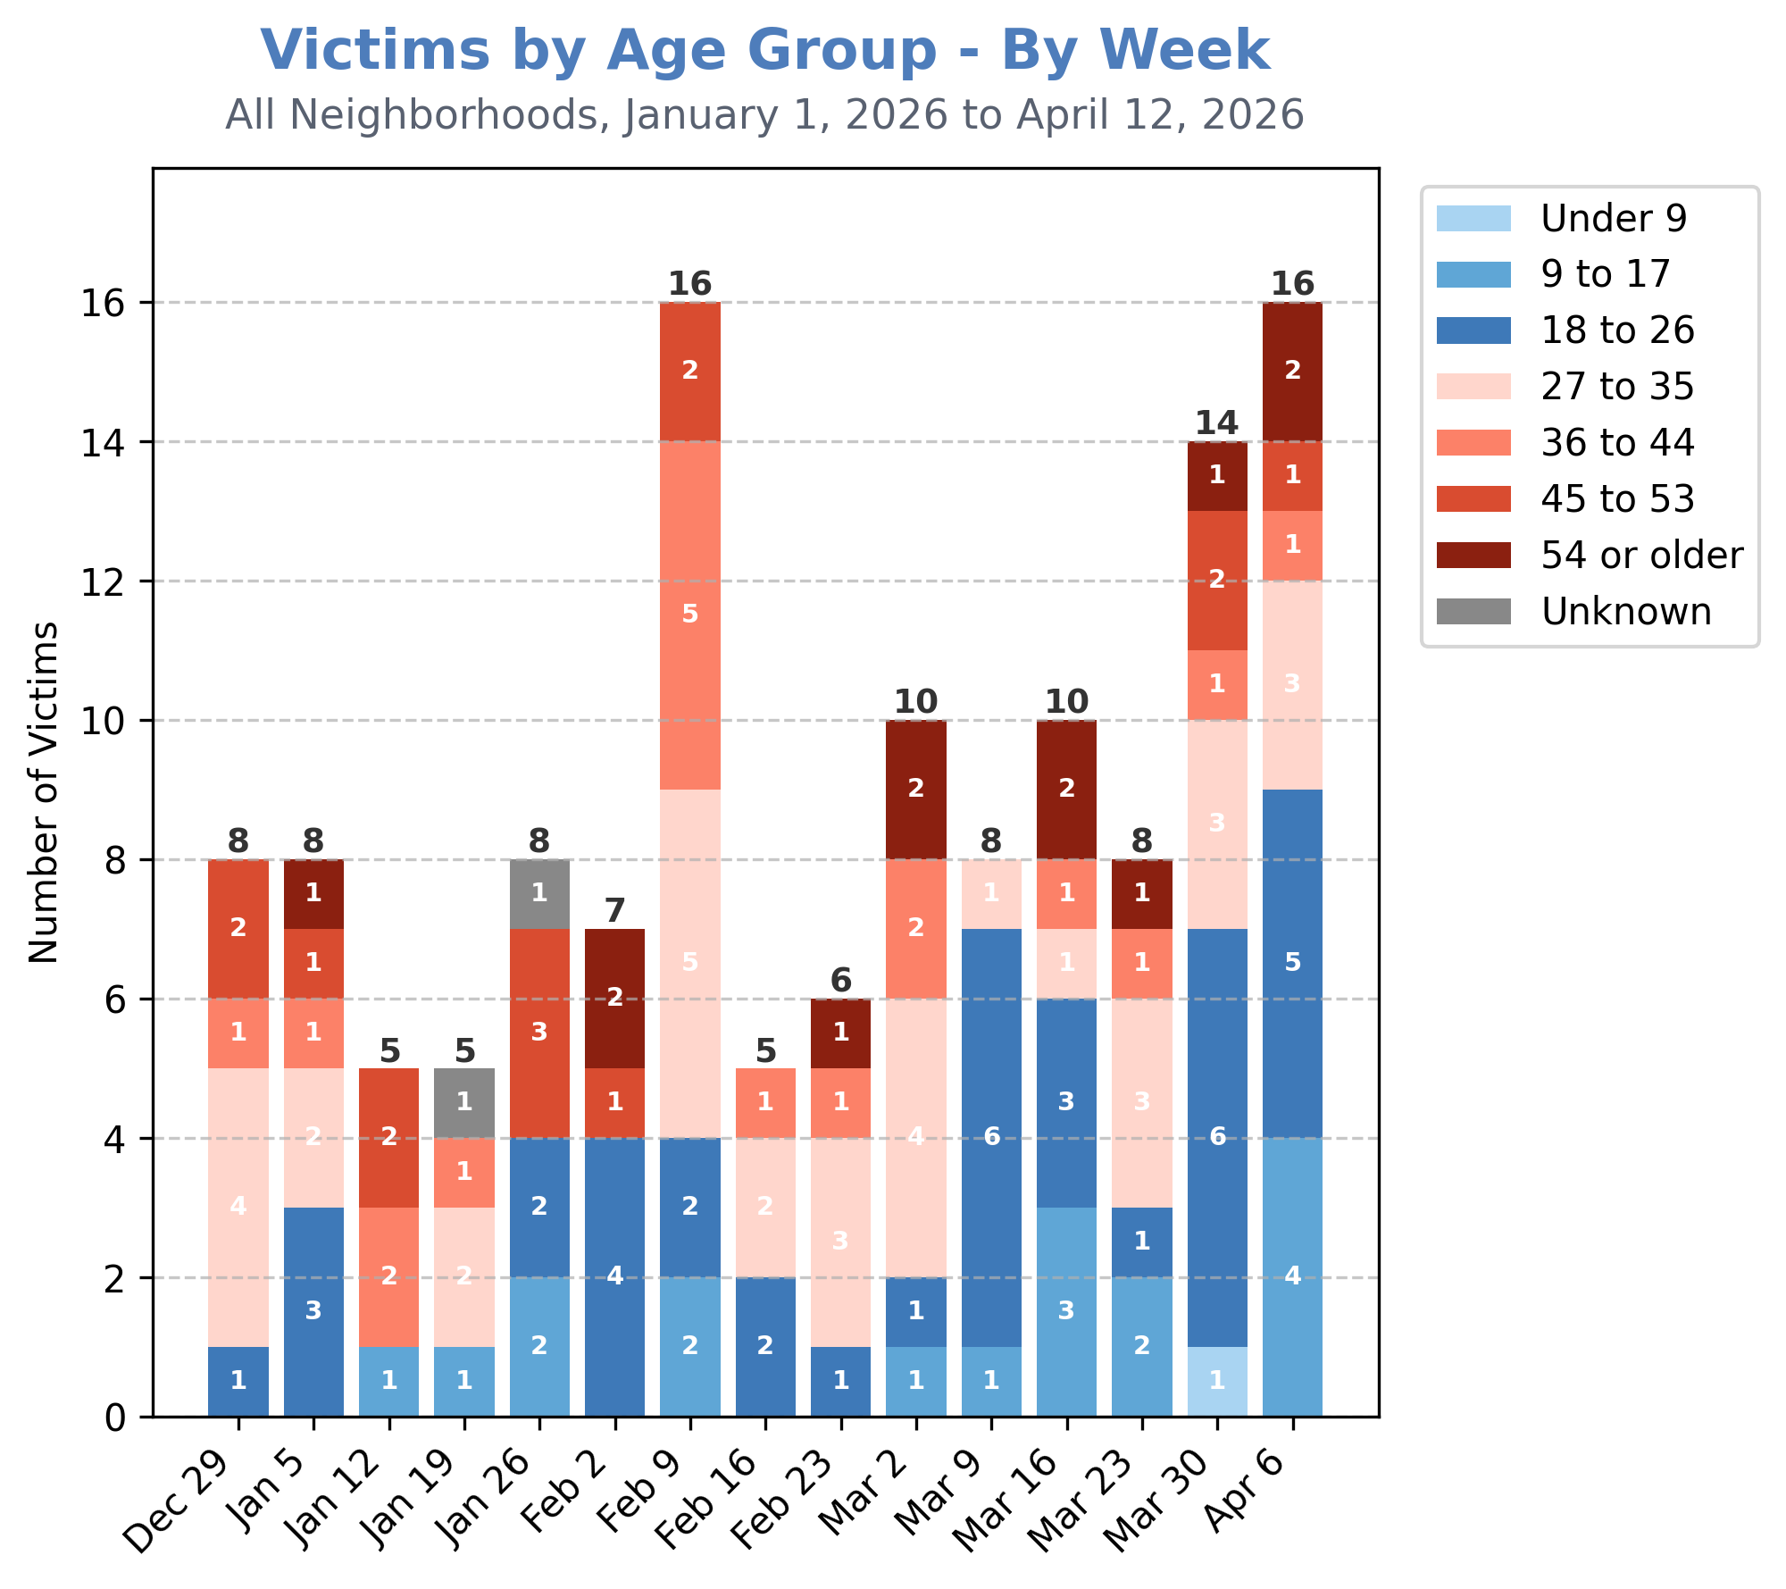
Most victims during the week of April 6th were over 18-years-old (12 of 16).
There were 4 shooting victims under the age of 18.
The most victims (5) were between 18 and 26.

Slide 35
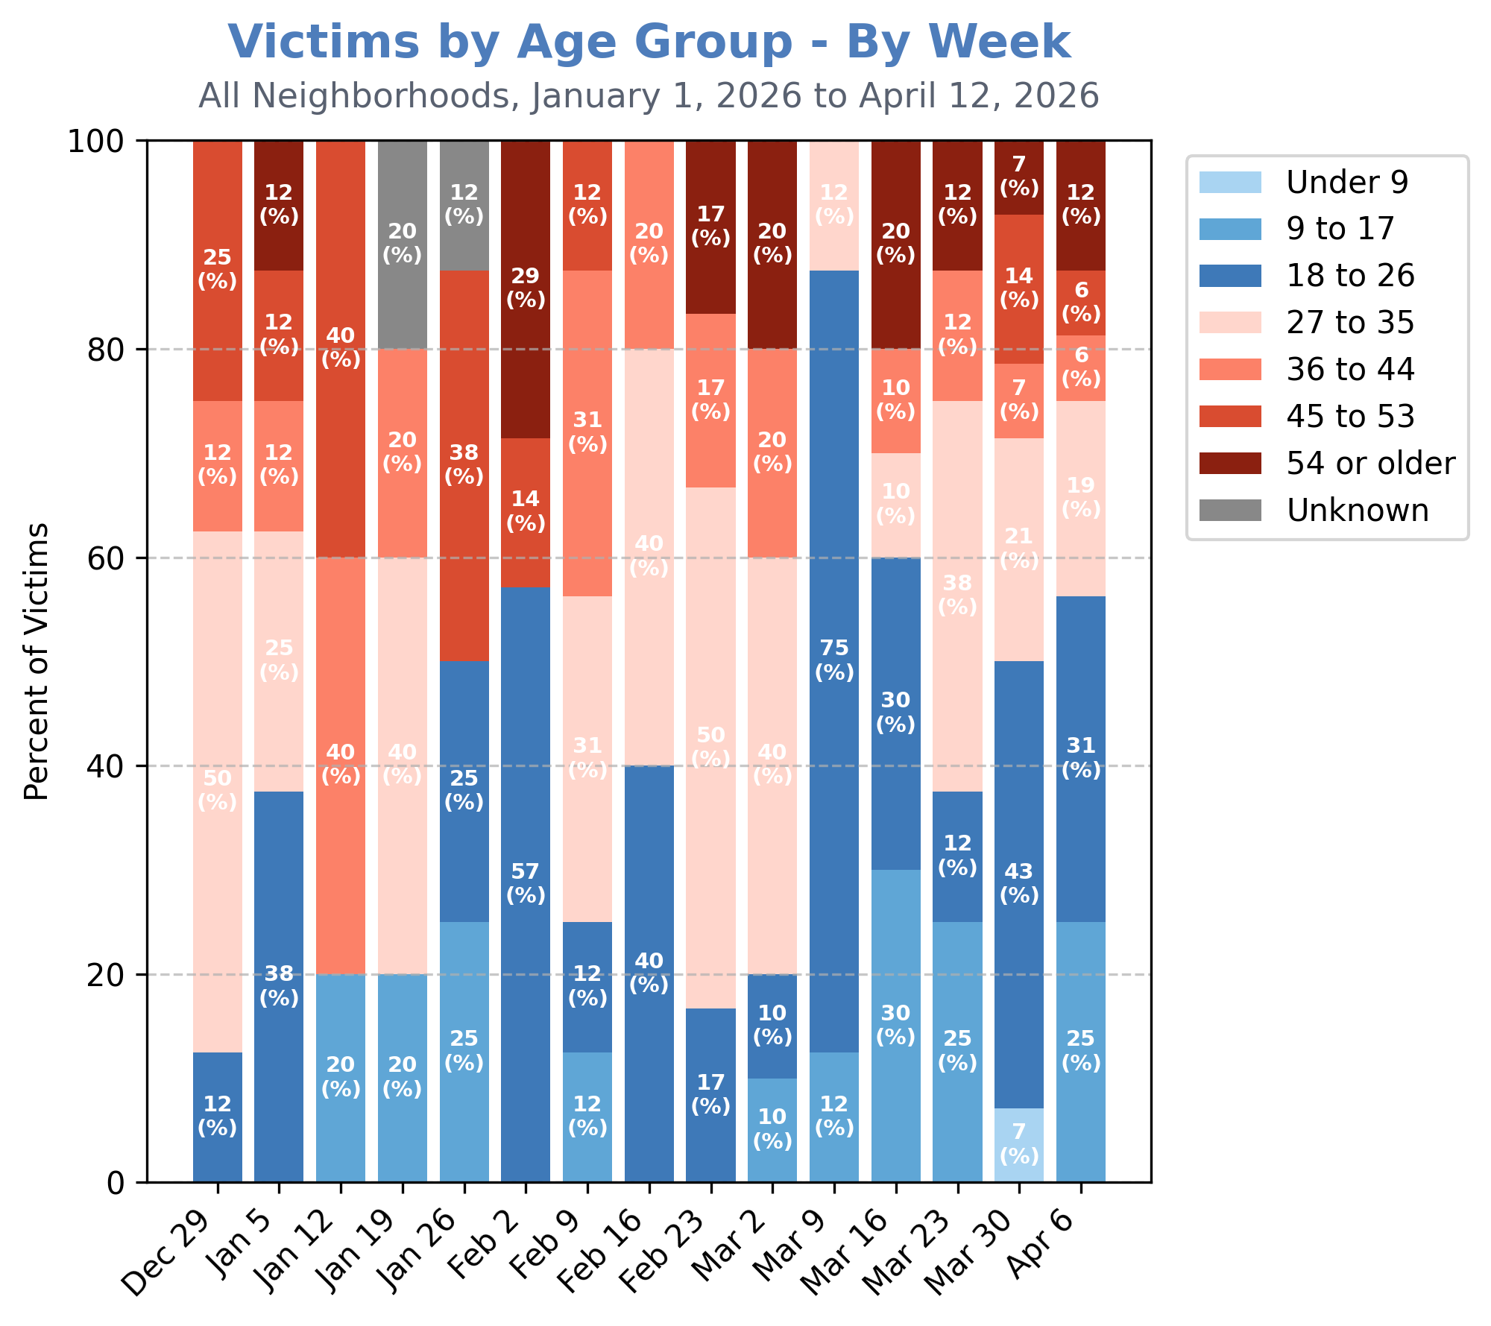
This means that 25% of shooting victims for the week of April 6th were under the age of 18.

Slide 36
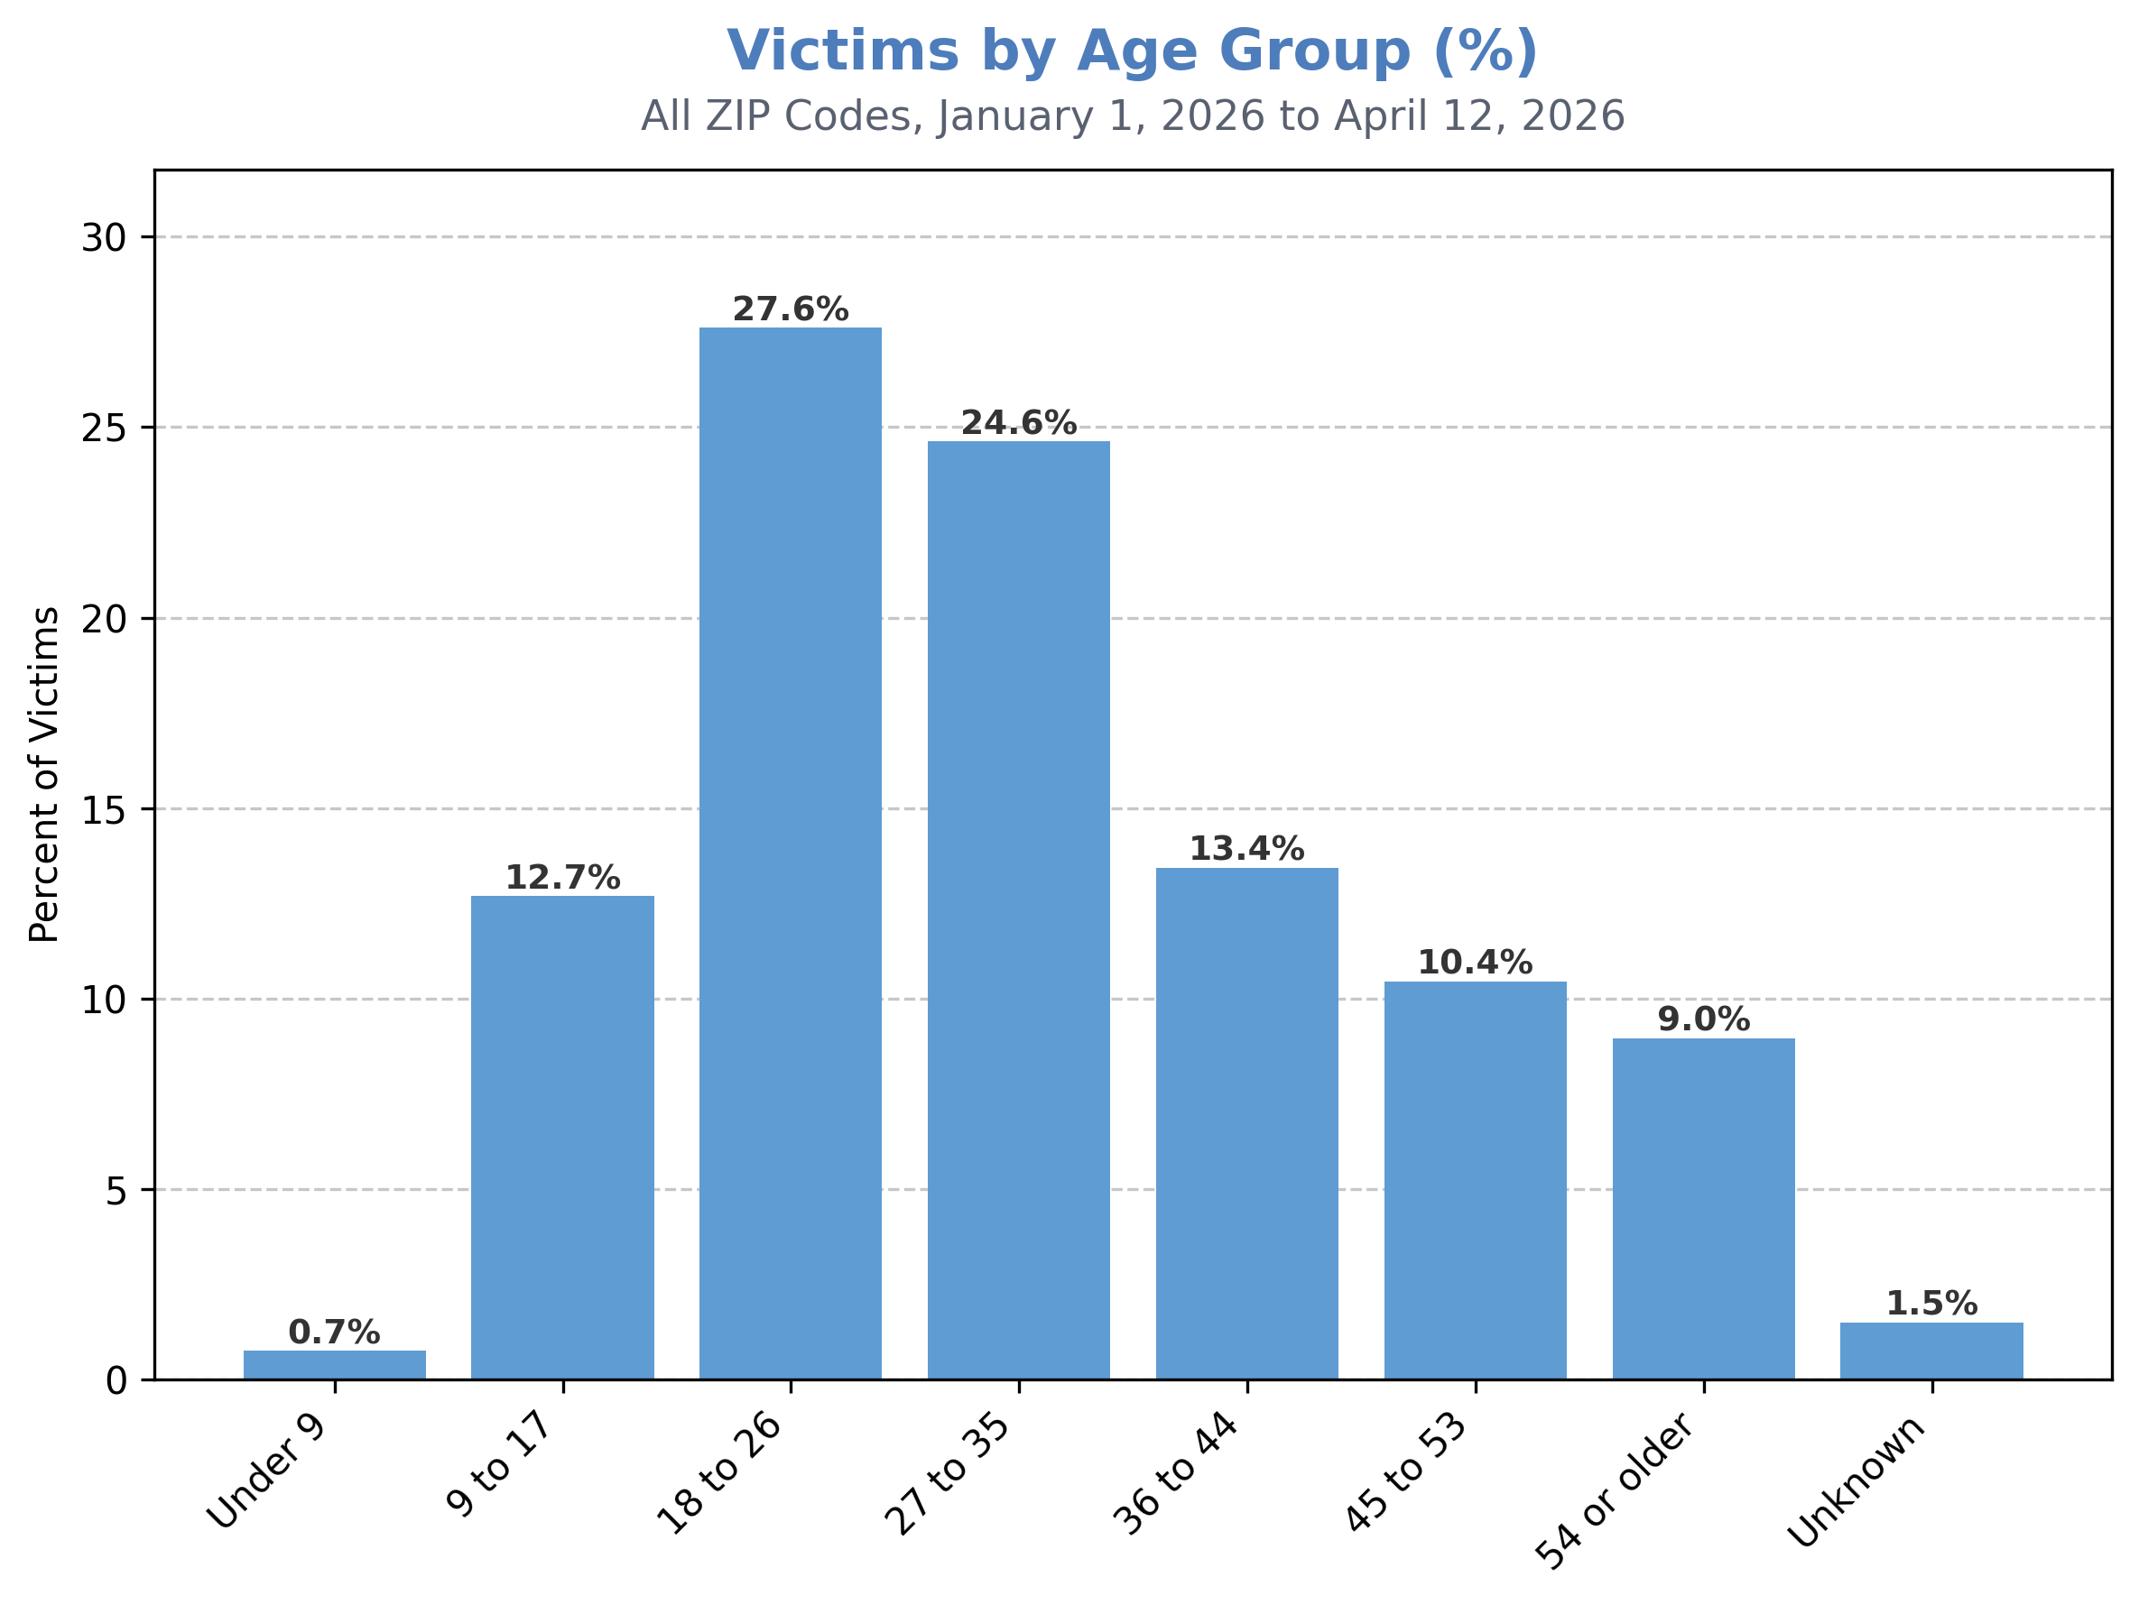
Year-to-date, approximately 13% of shooting victims have been youth under 18-years-old.
The most shooting victims have been 18- to 26-years-old (28%), with more than half (52%) between the ages of 18 and 35.

Slide 37

So What Next?
Interested in exploring more data trends to help take action in your local community?
All reports can be accessed free of cost at:
https://bethevariable.com/perform-reports/
Please don’t hesitate to contact us with any feedback, or to explore ways we can collaborate to drive impact:
info@bethevariable.com

